Slide 1
Content supports the learning outcomes and the assessment tasks
Learning outcomes underpin the course content
What makes our course engaging for our students?
Assessment tasks are relevant to future professional practice
Assessment tasks relate directly to the content
Notes:
Sara: So Sue, we have to create a presentation for the eLearning showcase.
They want us to talk about what makes our course engaging for our students.
Sue: OK…Why don't we tell them about: the importance of having the
Learning Outcomes underpin the Course CONTENT?
For example: If we say we want them to gain particular skills and knowledge, then it’s probably a good idea to
include that in the course content. I think it would be more likely to ENGAGE them in the course.
Sara: Sure… Another thing is that the assessment tasks relate directly to the content of the course. That
means that as they work through the topics, they know that they are learning stuff that they can use in their
assessments.
Sue: Yes – and turning it around the other way - we do want them to see that what they are doing in the course
relates directly to the assessments they’re going to submit.
Sara: Right! Another thing is that the assessment tasks – which are related to the content of the course – are
also relevant to their future professional practice.
They have to: research and share teaching resources relating to the arts,
collaborate with a partner to plan a unit of work– just like real teachers do!
Sue: Of course the other thing is that we do try and have variety in the content. We have readings, videos,
activities, forums, discussions, just to make it interesting and unpredictable.

Slide 2
Always reply to
emails in a timely manner
Different modes of explanation
Step by step
instructions
Using
“Discussion Forums”
with replies required
HOW do we engage our students?
Video elaboration
of tasks
Regular “News Forum” posts keep
students informed
and creates a community of learners
Explicit connections made
within Moodle topics
Notes:
Sue: So that’s what makes the course itself engaging.
But we need to also talk about how we engage the students in the course.
We know it’s engaging – but how do we get them to engage with it?
Sara: It sounds very obvious…but we could tell them about - Always replying to emails
it means they’re not waiting around – and they feel that you want to help them.
Sue: Yes – we also REQUIRE them to contribute to the discussion forums.
Sometimes they get involved in a discussion that they weren’t initially interested in,
but, then they find that they actually have some ideas to contribute.
Sara: We could tell them how we use the News Forums to keep them engaged with the topic for the
week or the assessment tasks – like a weekly reminder of what they’re supposed to be up to.
Sue: The other thing is that we try to explain assessment tasks in a range of different ways –
Of course the assessments are in the Course Description.
But we also have step-by-step instructions in Moodle
And there’s also a video explanation – that has had 345 views – so they obviously
look at it more than once… multiple access points to make sure they understand what they need to do
Sara: The other thing is that the topics in Moodle are sequenced so that they are directly
connected with the assessment tasks. For example - 3 weeks, three sequential topics –
Contemporary artists…Indigenous and Asian arts…

Slide 3
Structure of Assessment Tasks
Spread over time - three opportunities
How do we KNOW our students are engaged?
Requires students to engage with each other
Opportunities to improve their final submission
Promotes collegiality through research and sharing
Supports professional practices of giving effective feedback and collaborative planning
Notes:
Sue: OK. But we also need to explain how we KNOW that the students are engaged.
Sara: Alright. We could give an example – how about the way that the
assessment tasks are structured to engage the students?
Sue: Sure. Such as… that the first assessment is spread over three weeks
and the students have to share three different posts to a Forum.
They get a few chances to work on the quality of what they post after they’ve seen what
other students have done.
Sara: Yes. The other thing is that they are continually engaging with each other
because they have to give each other feedback for the three weeks.
So we’re promoting collegiality by getting them to do some research and share what they have found.
Sue: The other thing is that they have the chance to revise their work on the basis of the feedback
they have been given from other students before they submit their final draft for marking.
This means that the whole process of giving and receiving feedback has a legitimate purpose.
Sara: And as far as the second assessment goes, we ask them to develop a unit of work with a partner –
so it’s a reflection of a real professional practice, and again, they have to upload the
unit to share with each other.

Slide 4
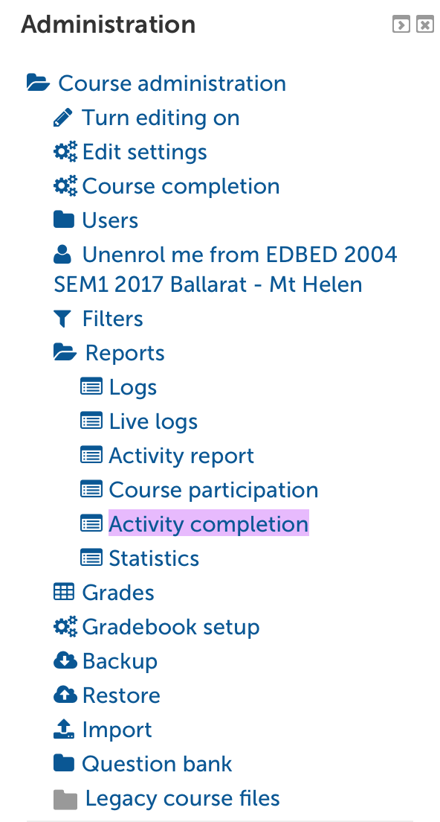
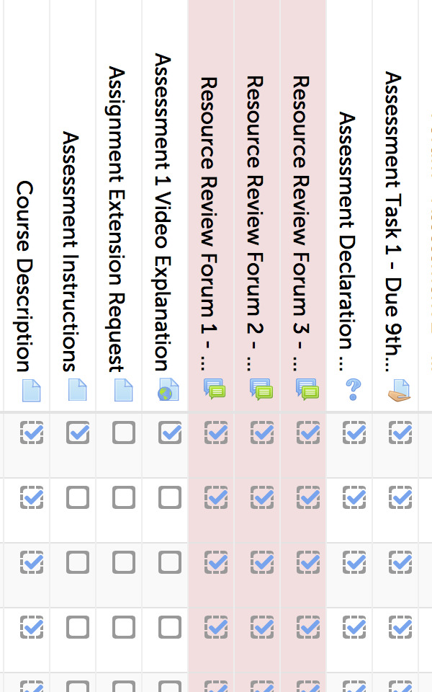
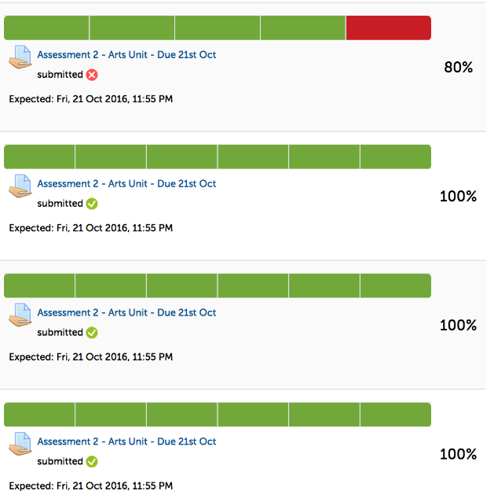
Use of Moodle features
We track students
Students track themselves
How else do we KNOW our students are engaged?
Release of content is based on completion
Activity report
Progress Bars
Can include:
Topic completion
Assessment tasks
Notes:
Sue: There must be something else we do so we know the students are engaged in the course?
Sara: How about the way that we use the features in Moodle?
Sue: Yes – do you mean like the way that we track them and how they can track their own progress?
Sara: Yes – Like the progress bars – they can track what they’ve completed the topics and
also the assessments, and we can easily see who has completed what and if they’re on
track as far as the timing.
Sue: The other way we use Moodle is by only releasing the topics after they have completed
the previous ones – it’s a progressive release of the content.
Sara: And we can use the activity reports in Moodle to see what each student has done – and follow
up with anyone who is falling behind.
Sue: It just means that we can use the features of Moodle to help the students stay engaged
with the course as the semester progresses.

Slide 5
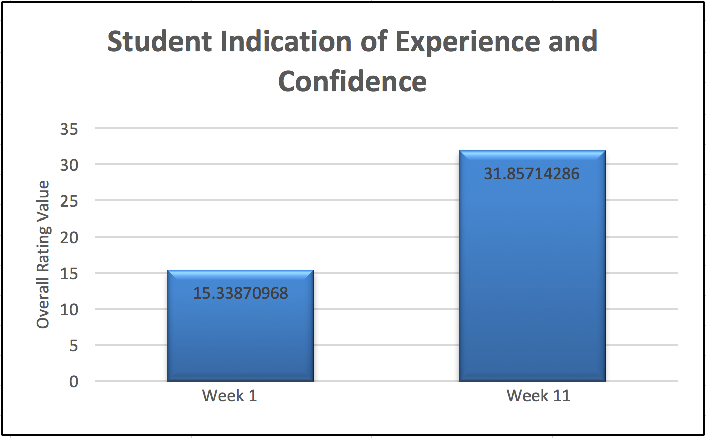
Pre Course
Survey
Post Course
Survey
How ELSE do we know our students are engaged?
Survey questions
are linked to
course learning outcomes
Has their engagement resulted in learning?
What’s the point?
Complete to
commence Topic 1
Complete to submit
the final assignment
100% return rate!
Analysis reports Feedback on course content and delivery Self evaluation of their learning
Notes:
Sara: Alright. Well what else is there? How else do we know they’re engaged?
Sue: How about the pre 2 and post-course surveys?
Sara: Sure. The survey questions are based on the course learning outcomes, so they
give us a good indication of where the students are at before they start the course, and
then where they are at after they have finished.
Sue: Yes. So we ask the students to self-evaluate their own learning, and we also ask
them for feedback on the course content and how it’s delivered.
Sara: And of course, we make completing the surveys a requirement before the students
can commence Topic 1 (for the pre-course survey), and they have to complete the
post-course survey before they can submit their final assignment – so we get a 100% return rate!
Sue: Exactly! And we can then analyse the results to see what the students think they have
learnt and what they think has been valuable to them. So just in relation to student engagement,
what would we say is the point of the surveys?
Sara: Well… we want the students to engage in the course, but only because we believe that this
will result in them actually learning something. So we can look at the analysis reports
from the two surveys and see whether they think that they have learnt something!
We can also combine that with the results of their assignments.
Sue: And we can then get a comparison of the perception with the reality – and hopefully see that
engagement in the course has achieved the course learning outcomes – the circle is complete!
Sara: Great! Well that’s probably enough for now - So do you think that we can say all that in 8 minutes?
Sue: Yeah…I think we can. ☺
Sara: (calls) Hey Sue – What are we going to call it?
Sue: (calls) How about…Rules of Engagement?

