Slide 1
ARC Rejoinder Information Session
Peer review process
&
How to write a Rejoinder
Tina D’Urbano
Research Funding Team
research.funding@federation.edu.au
23 June 2014
Sources & acknowledgements: ARC website, some information adapted from other institutions

Slide 2
What is an Assessor Report?
Peer review comments made by the external assessors (CoE Members, Detailed Assessors and General Assessors) in relation to the selection criteria about your proposal
What is a Rejoinder?
Applicant’s response to the Assessor Reports –
It’s your opportunity to constructively respond to comments and criticism made by Assessors
Rejoinders provide information for the CoE panel members who decide which proposals are fundable
Rejoinders are not viewed by external assessors – they are considered by ARC CoE Panels when deciding the overall ranking of proposals

Slide 3
General overview - NCGP & Peer Review Process
http://www.arc.gov.au/general/assessment_process.htm & http://www.arc.gov.au/ncgp/default.htm (19-6-14)
The ARC funds research and researchers under the National Competitive Grants Program (NCGP).
This comprises two main elements - Discovery and Linkage - under which the ARC funds a range of complementary schemes to:
support researchers at different stages of their careers, Relative to opportunity + / -
build Australia’s research capability,
expand and enhance research networks and collaborations, and
develop centres of research excellence.
The majority of funding decisions under the NCGP are made on the basis of peer review.

Slide 4
Peer Review Process
Peer review of proposals may be undertaken by:
members of the ARC College of Experts (CoE); - currently 158 members
Assessors and/or other eminent researchers. - approx 19,000
ARC CoE members divided among five panels:
Biological Sciences and Biotechnology (BSB),
Engineering, Mathematics and Informatics (EMI),
Humanities and Creative Arts (HCA),
Physics, Chemistry and Earth Sciences (PCE), and
Social Behavioural and Economic Sciences (SBE).

Slide 5
Characteristics & roles:
ARC College of Experts (CoE):
experts of international standing drawn from the Australian research community, including higher education, industry and public sector research organisations.
appointed by the Minister for terms of 1 - 3 years.
annually the ARC conducts a competitive nomination process to replace retiring members.

Slide 6
ARC College of Experts (CoE) – cont.:
assign Assessors to Discovery Projects proposals
participate in selection panels for the ARCs Discovery Projects and Linkage Projects schemes,
submit initial assessments,
review Assessor assessments and applicant rejoinders,
rank proposals, and
make funding recommendations to the ARC CEO
provide strategic advice to the ARC on emerging disciplinary and interdisciplinary developments, and innovative approaches to research.

Slide 7
Assessors and/or other eminent researchers:
readers whose research interests span the broad field/s of the research projects they are asked to assess (General Assessors), or
experts (Detailed Assessors) in the specific field of a proposed research project,
assess proposals against selection criteria in the funding rules
score, rank and provide written comments for each proposal.

Slide 8
Assessors and/or other eminent researchers – cont.:
new Assessors are selected through CoE member nominations
each year the ARC reviews successful proposals and, where suitable, adds funded researchers not already listed to the Assessor database.

Slide 9
Assignment of proposals
Proposals are matched to a selection panel using the Fields of Research (FOR)
ARC Executive Directors review the appropriateness of the proposals in each panel and may transfer proposals to different panels if required.
They also identify interdisciplinary proposals that will require assessors from more than one selection panel.
In Discovery Projects, CoE members also assign up to four Assessors per proposal.
Assessors may decline to assess proposals if they consider it to be outside their area of expertise or a conflict of interest

Slide 10
Assessment process – Selection and Scoring
Assessment forms
CoE members and Assessors assess the merits of a proposal against selection criteria in funding rules
submit assessment forms through RMS
typically assessment forms request scores and written comments for each selection criteria

Slide 11
Selection criteria – track records
Selection criteria and weightings vary from scheme to scheme:
Most scheme selection criteria include investigator track record and proposed program of research components.
When assessing the track records of researchers nominated in a proposal, assessors are advised to take into account the opportunities that the researchers have had to build their research profile.
- need to take this on board when considering submitting an application = build your research profile and track record

Slide 12
Scoring Bands
The ARC provides the following advice to assessors on the degree of merit associated with specified scoring bands as a guide.
A: Outstanding – Of the highest quality and at the forefront of research in the field. (~10%* of Proposals should receive ratings in this band.)
B: Excellent – High quality research and a strongly competitive Proposal. (~15%*)
C: Very good – An interesting, sound and compelling Proposal. (~20%*)
D: Good – A sound research Proposal, but lacks a compelling element. (~ 35%*)
E: Uncompetitive: The Proposal is uncompetitive and has significant weaknesses or more fatal flaws. (~20%*) *Percentages are provided as a guide only.

Slide 13
Rejoinders
at last these are released = here’s your chance to fight for your proposal
Once the initial assessments are submitted to the ARC, researchers are invited to respond to the written comments [only] from the assessors.
- Scores and assessor details are not released to applicants.
Rejoinders allow applicants and nominated participants the opportunity to clarify any misunderstanding or difference of opinion about perceived weaknesses in the proposal.
- It also provides an important feedback mechanism that may help researchers in future proposals.
The assessors' reports and the rejoinders also assist the ARC CoE members in reviewing proposals.

Slide 14
Selection Meetings – after rejoinder process
CoE members attend selection meetings to rank the proposals and determine to what extent they ought to be funded.
A recommendation for funding is made to the ARC CEO.

Slide 15
Ranking of proposals
To determine a final ranked list, the selection panel considers and discusses proposals – particularly those around the funding margin.
Selection panel members may revise the ranking of a proposal in response to a number of factors including:
assessor reports;
persuasive rejoinder arguments; and
panel discussions comparing the relative merits of proposals against the selection criteria.
and
taking into account any ranking anomalies.

Slide 16
Assignment of budgets
Once a CoE selection panel has determined the final ranked list of proposals, members determine funding recommendations for all proposals in the fundable range.
Awards outcomes - ARC CEO’s recommendation
On advice from the CoE, the ARC CEO makes funding recommendations to the Minister.
Approval of proposal expenditure rests with the Minister.
Generally, the Minister acts on advice from the ARC CEO.

Slide 17
OK, so what’s the chances of success?
Discovery Projects
 | 2010 | 2011 | 2012 | 2013 | 2014
Submitted | 4068 | 4230 | 3544 | 3425 | 3534
Funded | 925 | 931 | 778 | 732 | 703
Success Rate | 22.7% | 22.0% | 22.0% | 21.4% | 19.9%
DECRA Projects
 | 2012 | 2013 | 2014
Submitted | 2159 | 1281 | 1468
Funded | 227 | 200 | 200
Success Rate | 12.8% | 15.6% | 13.6%
Source: ARC research funding trend data, Success rate of proposals by scheme, by funding commencement year, http://www.arc.gov.au/general/searchable_data.htm (19-6-14)

Slide 18
Writing a Rejoinder
- How to read your Assessor Reports
- Where to start?
Tips – what to do /what not to do
- Rejoinder Process Instructions

Slide 19
ARC Rejoinders http://intranet.monash.edu.au/researchadmin/arc/arc-rejoinders.html
The purpose of the Rejoinder process is to allow Applicants to respond to assessment comments made by external assessors.
Rejoinders are not viewed by external assessors but are considered by an ARC College Panel when deciding the overall ranking of a Proposal.
Applicants and named participants are given access in RMS to the Assessor Reports and the Rejoinder form.

Slide 20
IMPORTANT
Normally a 2-week turnaround for rejoinders
Rejoinder text is limited to 5000 characters
Use it wisely

Slide 21
Before you start
You should definitely write a rejoinder no matter how good (or bad) your assessor reports are – can’t always assume the assessor’s scores match what they write.
View it as a ‘bonus’, an opportunity to argue your case and, if written well, increase your chances of success.
Remember your Rejoinder goes to the CoE panel member – not the assessor; give your champion ammunition to help get your proposal over the line.
Understand what you are trying to achieve – make a plan, what will be the structure, what needs to be addressed and what doesn’t.

Slide 22
How to read your Assessor Reports
Read, Read and Re-read – try to keep an open mind
Think – take your time – give yourself time to react and neutralise any emotional reaction
Digest the comments – show it to colleagues, ask for advice
Write the first draft – and then put it aside
Be careful not to misinterpret comments and criticism
Check your proposal – Was it clear? Did the reviewer miss something important that might help your panel champion?
Generally, assessors won’t know who you are – they are not making personal attacks; think about why they wrote what they did.

Slide 23
Where to start?
Highlight the comments and criticism that need to be addressed.
Determine whether the criticisms are accurate or not - if they are, say how the concern will be addressed. - if not, say why not
Use the criteria headings to structure your response
Be brief and systematic – quote and respond, quote and respond
Identify the Assessor for each response - similar comments from more than one Assessor group the response (e.g. “Assessor 2 similar”)

Slide 24
Where to start? - cont
Don’t waste space discussing all the positive comments (unless it’s all positive!) - they’ve read your proposal and reports; - so focus on the criticism and issues that need to be addressed
Only if space permits, very briefly acknowledge positive comments
Write it – put it aside (time permitting) – edit
Ask colleagues for feedback

Slide 25
TIPS – Dos & Don’ts
DO:
Allow yourself to react, get annoyed and complain – then work out a strategy to respond
Write in a clear and concise manner
Use a positive and conciliatory tone
Put emphasis on why your proposal is worth funding
Consider each assessor’s comments seriously

Slide 26
DO – cont:
Respond to every critical comment – address them directly
Acknowledge something you may have gotten wrong
Be succinct and avoid overly technical comments – they may have a broad knowledge but may not be an expert in your field
Remember reviewers are experts within their fields – potentially they are correct
Provide an indication of the comment to which you are responding.

Slide 27
DO – cont:
Help the College of Experts to see the proposal from your point of view.
Stick to the main points. Whenever possible, a short rejoinder is a good rejoinder
Put criticisms into perspective
Use it as a learning experience – what would you do differently next time?
Rejoinders are optional – but highly recommended.
If you don’t want to submit – you must state this in RMS

Slide 28
DON’T:
Don’t take it personally or jump to conclusions
Don’t argue with or be hostile to an Assessor – point out any factual errors and respond accordingly
Don’t play assessors off against each other
Don’t be mislead by general positive comments – may not equal a high ranking
Don’t try to guess your scores or ranking – comments can be misleading – focus on the issues that need addressing
Don’t over react – see it as a potential positive
Don’t nit-pick or complain – if they misunderstood something, clarify it (politely)

Slide 29
DON’T – cont:
Don’t regard unexpected criticism as having no ground
Don’t request that comments be disregarded without providing a good reason
Don’t criticise or question the assessors’ competence or expertise
Don’t hide away from negatives by only focusing on the positives
Don’t over do it – give clear, succinct responses explaining why you should be funded, be careful of using technical details
Don’t add new information, updates, etc.* – assessed by what was in the proposal

Slide 30
DON’T – cont:
Don’t give up!
- you’ve put the effort into this project;
- can it be funded elsewhere?
Rejoinders are optional – but highly recommended.
If you don’t want to submit – you must state this in RMS

Slide 31
What if you don’t get an Assessor Report?
Not likely – but still submit a Rejoinder.
This is when you can tell the panel about new developments, new work, successes, publications, etc.

Slide 32
Assessor Reports are released!!!!!
Lead CI will receive email notification from ARC.
Research Funding Team will also be in touch.
How to go about it?

Slide 33
ARC Rejoinder Process Instructions
**Edited by Tina D’Urbano; Full document can be found at http://www.arc.gov.au/applicants/assessor_rejoinders.htm
Applicants and nominated participants are given access to the Rejoinder form in the ARC Research Management System (RMS)
- able to access the assessors' reports and
- have an adequate, though brief, period for submitting a rejoinder.
Queries or requests
Applicants should direct queries or requests to the Research Office at the Administering Organisation. Research.funding@federation.edu.au
Do not contact ARC directly

Slide 34
Section 1: Instructions for Applicants
1.1 Log on via the ARC Research Management System (RMS)
All participants listed on the Proposal with ‘Edit’ rights can view, edit and submit Rejoinders to the Research Office.
Log on via the RMS at https://rms.arc.gov.au using your User Id and password.
Note: If you have forgotten your password or User Id please select ‘Reset Password’ or ‘Retrieve User Id’ link on the RMS homepage and follow the prompts.

Slide 35
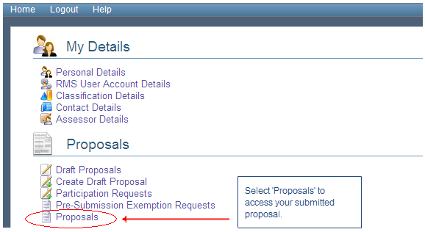
1.2 View Proposals
To access your Proposal/s submitted to the ARC please select the ‘Proposals’ link under Proposals.

Slide 36
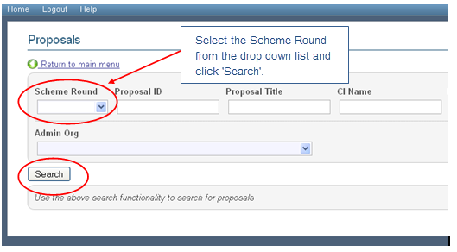
Select the relevant scheme from the ‘Scheme Round’ drop down list and then click on the ‘Search’ button.

Slide 37
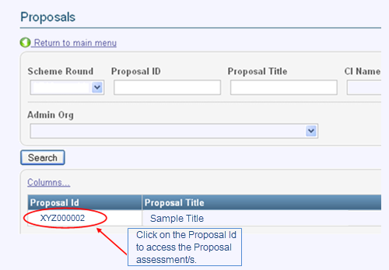
A list of your Proposal/s submitted to the ARC for this scheme will appear in this screen.
To access the assessment/s for the submitted Proposal please click on the Proposal Id.

Slide 38
1.3 Accessing assessor comments
After clicking on the Proposal Id you will see a screen listing the Proposal and a series of tabs.
The first tab ‘Assessment’ will show links labelled as Assessor ‘A’, ‘B’, ‘C’ or ‘D’ which contain the assessment comments for your Proposal.
** note: you will receive up to 4 Assessor Reports, some may have less

Slide 39
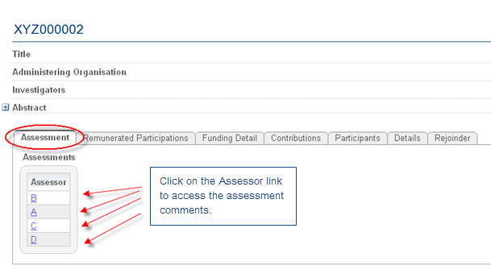
To access the assessment comments, click on the individual Assessor links

Slide 40
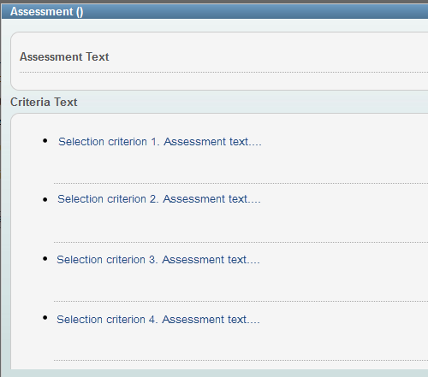
Clicking on an Assessor link will show a new screen where the assessment comments can be viewed against the selection criteria.

Slide 41
Note - Downloading the Assessor Reports:
While the assessment text cannot be printed, it can be copied by:
selecting all of the text in the Assessment window,
right-clicking and selecting ‘Copy’,
and then pasting the text into a Word document
Recommended that you draft your Rejoinder in Word
then paste it back into RMS

Slide 42
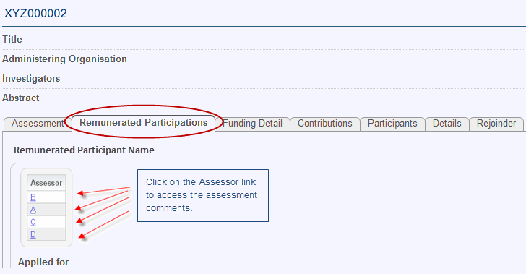
Remunerated Participant
If there is a remunerated participant request, such as Discovery Indigenous Award (DIA) or Discovery Outstanding Researcher Award (DORA), you will need to select the second tab ‘Remunerated Participations’ to access the assessment comments for the remunerated participant.

Slide 43
1.4 Edit and save a Rejoinder
To submit a Rejoinder click on the tab entitled ‘Rejoinder’.
You will then be able to enter your Rejoinder text to a maximum of 5000 characters (including spaces).
As the Rejoinder field is for text only, pictures, graphs or other documents cannot be inserted or attached.

Slide 44
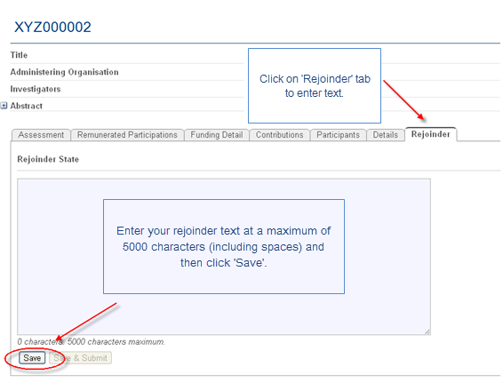
When you have completed your Rejoinder
Click on the ‘Save’ button to save your Rejoinder text.

Slide 45
1.5 Submitting your Rejoinder to the Research Office
Once you have saved your Rejoinder the ‘Save & Submit’ button will no longer be greyed out and will become active.
To submit your Rejoinder to the Research Office please click

Slide 46
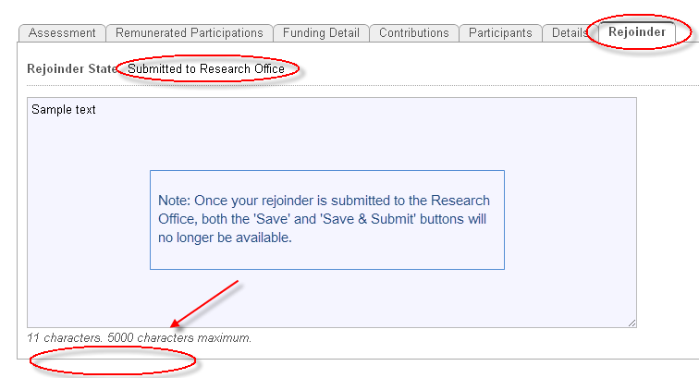
The Rejoinder State will change from ‘In Draft’ to ‘Submitted to Research Office’ once the ‘Save & Submit’ button has been selected.

Slide 47
Note:
If you wish to make any further changes to your Rejoinder once the Rejoinder State is at ‘Submitted to Research Office’, you will need to contact the Research Office to have the Rejoinder desubmitted back to an ‘In Draft’ status.
If no further changes are needed the Research Office staff will then submit your Rejoinder to the ARC.
Alternatively, the Research Office will be able to edit the Rejoinder on your behalf before submitting to the ARC.

Slide 48
1.6 Submitting your Rejoinder to the ARC
The Administering Organisation’s Research Office will submit the Rejoinder to the ARC.
- You cannot do this, so please let us know when it is ready.

Slide 49
Dates & Deadlines
Rejoinder Open and Close dates for each scheme are made available on the ARC Important Dates website http://www.arc.gov.au/media/important_dates.htm.
Currently only an indicative time period is listed: DP – end June, DECRA early July Exact dates will be on the website once the Rejoinder period opens.
The first named participant on each proposal will receive an automated email from the RMS informing them of the opening of the Rejoinder period.
A network message will also be issued to Administering Organisation Research Offices, informing them of the opening of the Rejoinder period.

Slide 50
Internal Support & Final Deadlines for Submission (tbc)
ARC allow around two weeks to respond to Assessor Reports
Internal review deadline
~ 4 days before ARC closing date
Expert/Academic review and feedback
Administrative and Compliance review

Slide 51
Timeline example (tbc)
ARC Release Tues 24th June - ARC close Mon 7th July
Internal review deadline (about 10 days from release) – 12 noon Thurs 3rd July
- Research Funding Team distribute to reviewers – by 5pm Thurs 3rd July
Feedback Returned to Applicant – by Sat 5th July
Final Rejoinder submitted via RMS - 12 noon Sun 6th July
Please notify us via email when you have uploaded your rejoinder
Research Funding Team submit Rejoinders to ARC by 5pm Mon 7th July
*** RMS will be busy – and may be slow *****

Slide 52
Final comments
HOW OFTEN DO REJOINDERS MAKE A DIFFERENCE?
With rare exceptions, they only make a difference if your grant is near the cutoff for funding.
However, they can make a big difference.
If your grant is near the cutoff, you need to engage the support of the COE member. He/ she can argue your grant above or below the line.
THE REJOINDER IS YOUR ONLY MEDIUM TO GET THIS SUPPORT!
Use the process as a learning experience

Slide 53
and finally, We wish you success with your proposals and rejoinders
Further information:
ARC – Information for Applicants - Rejoinder Process http://www.arc.gov.au/applicants/assessor_rejoinders.htm

Slide 54
Research Funding Team Contact:
Jane Eltringham – 5327 6735
Tina D’Urbano – 5122 6872
research.funding@federation.edu.au
Sources:
http://arc.gov.au/applicants/assessor_rejoinders.htm
http://www.arc.gov.au/general/searchable_data.htm
http://w3.unisa.edu.au/res/grants/docs/RejoinderGuidelines-June2013.pdf
http://www.research.qut.edu.au/development/downloads/resources/ARC_Rejoinder_Process_May_2013.pdf
http://www.monash.edu.au/researchoffice/arc/

Slide 55
Thanks
QUESTIONS ????

