Slide 1
Future VET priorities for the workforce of tomorrow - what VET should deliver and how do we know?
Robin Shreeve
Adjunct Professor Federation University, Honorary Senior Fellow L H Martin, University of Melbourne
Former CEO Skills Australia/AWPA; North Coast Institute; Western Sydney Institute/OTEN; City of Westminster College (UK)
Notes:
Thank you Erica and AVETRA for the opportunity to present today.
PAY MY RESPECTS TO TRADITIONAL OWNERS OF THE LAND – ELDERS PAST, PRESENT AND EMERGING
Present one scenario for the future of VET
What VET will deliver
How it knows what to deliver
Personal
Idiosyncratic – based on experience and reading research reports
Contentious
Critical – not of practitioners but policy makers
Strong future

Slide 2
Some preliminary remarks – my view you might not agree with
VET and TAFE (as public provider) are essential for economic and personal growth
VET and TAFE have strong futures: but
Impacted by growth of HE and technological change in workplace and education
Broad trends – will always be exceptions
Marketisation and industry leadership have not resolved issues identified 30 years ago
Loss of corporate memory
Undervaluing of educational perspectives
Notes:
Public vet essential
Despite issues strong future
50% of younger age groups have degrees
Multiple impacts of AI/technology
Ai in industry – drawing offices
But also Google courses
Impacts/failures of lass 30 years – industry leadership, churn lack of corporate memory, marketisation
Always be exceptions and outliers

Slide 3
Have we made progress in VET since 1990
Same issues – promotion and status of VET compared to HE. In 1990s, “Fantastic Futures”, TAFE NSW official training provider of Sydney Olympics and Para-Olympics. Then intensive marketisation of funding
Lack of corporate memory
Lack of educational perspective / background in senior VET leadership
Has this version of “industry leadership” resolved or improved the system
Notes:
Presentation by MD
Same issues as 30 years ago
Promotional campaign
Education – leadership & devaluation of teaching

Slide 4
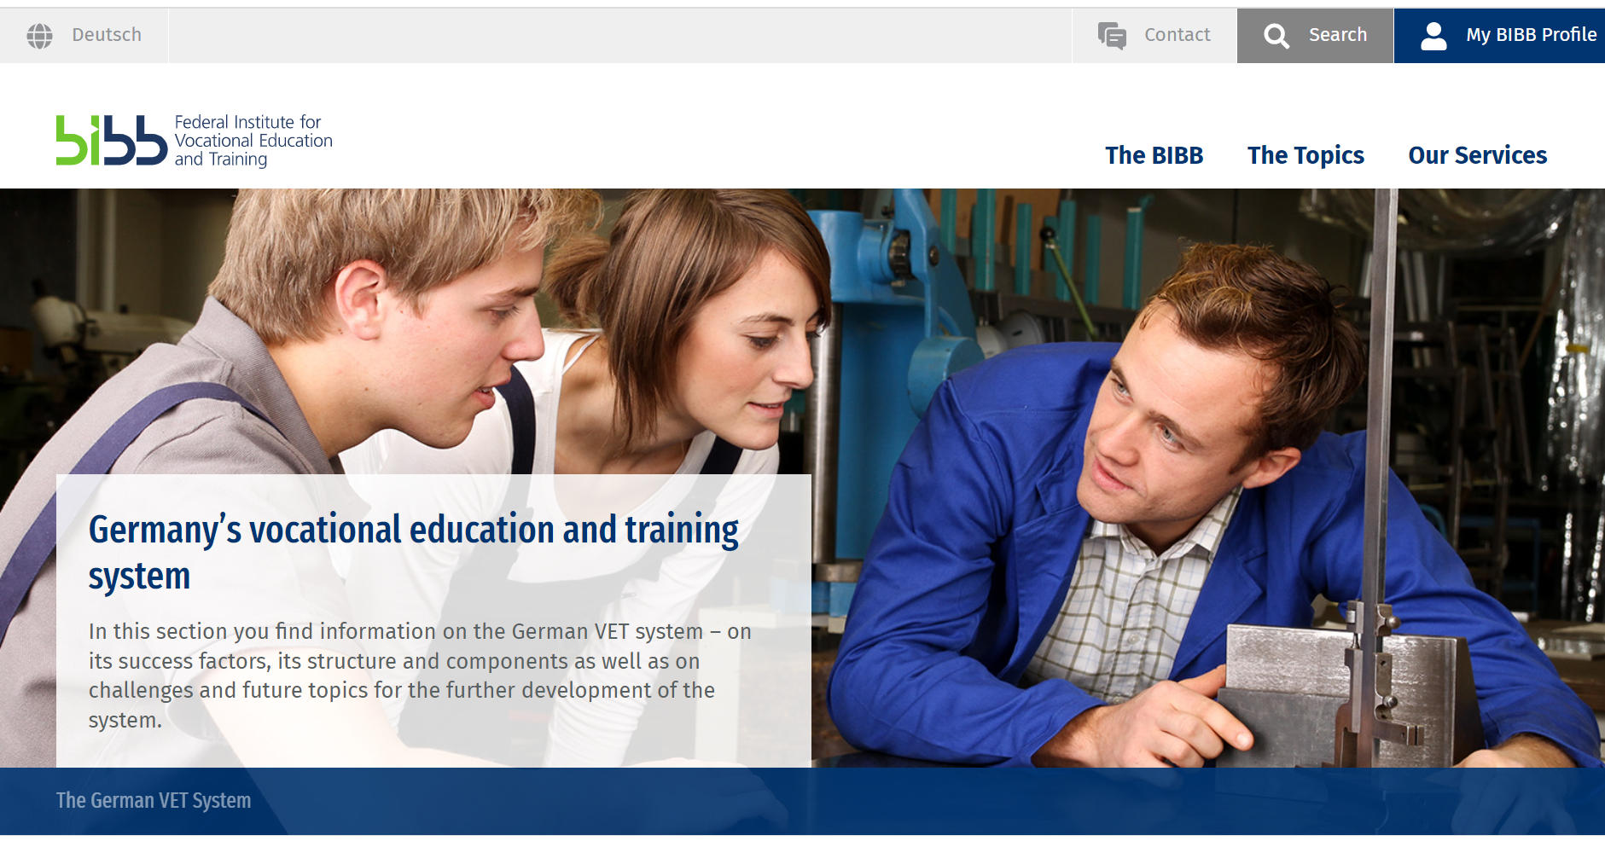
VET and Skills Peak Advisory Bodies in Germany and Australia since 1990
In Germany -1990s to now
In Australia 1990 to now
1990s – NBEET
2000’s – ANTA
2010s – Skills Australia
2010s – AWPA
2015 – NSC
2022 - JSA
Notes:
Day to day political interference
Continuity
Westminster
Susan Lee

Slide 5
Part 1 – Workforce Planning and Skills Shortages
Idealised models to identify and match demand and supply
Ever more sophisticated computer models of future workforce – Burning Glass etc
Flexible and fast VET/HE systems to deliver priority and majority skills
VET criticised for being “slow and inflexible”
Notes:
Idealised model
Problem better forecasting of shortages
More responsive VET providers
Better forecasting
Flexible system
How many auto mechanics at Grafton

Slide 6
NSC/JSA Industries Projected to Grow
Notes:
IS IMPORTANT to model
Has its limitations
Some VET/HE

Slide 7
Reality is less neat and tidy
Supply and demand for skills are very difficult concepts to pin down and measure, principally because many people learn their vocational skills on the job. While greater local interaction between industry and VET will improve understanding of the market, at the national and state level policy-makers must learn to live uncertainty. They should focus on: areas where markets do not work well; skills that take a long time to train; or shortages that cause major bottlenecks.
Notes:
People acquire skills through experience on the job
Use skills genericaly across occupations
Otherwise how else new jobs

Slide 8
Specialised occupations
Notes:
Concentrate on specialised occupations

Slide 9
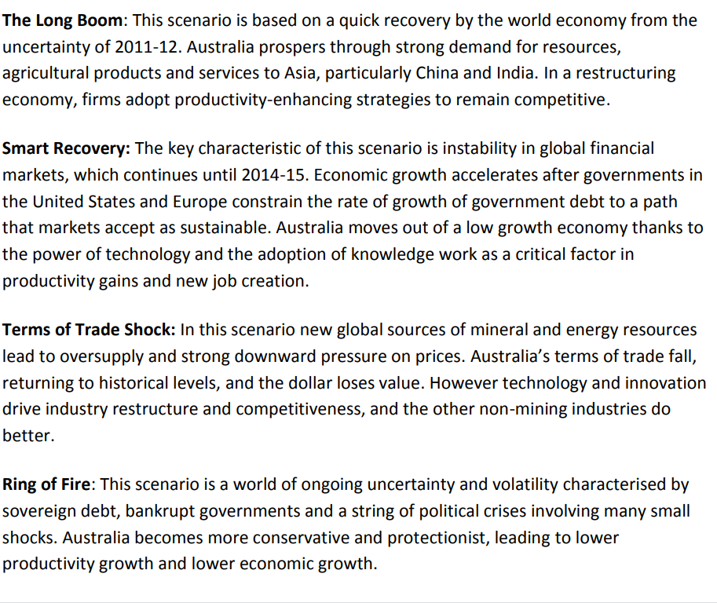
Notes:
Commonalities
Pandemic

Slide 10
The Shadbolt Dilemma (Ewart Keep)
Courses focussed on specific software packages and technologies (emphasis on immediate job readiness)
Or
Courses aiming to produce general awareness of the technology and its potential uses to create an understanding of the issues it raises (emphasis on deeper theoretical understanding)
Notes:
Generic use

Slide 11
Greatest skills deficits – impressions at AWPA
Experience (Q – how does a school leaver enter the mining industry; A – they don’t)
General skills but especially mathematical and quantitative skills across all industries at all levels. (You can teach a health care assistant in a short courses to aspirate injections – but if they do not understand the difference between 0.5 and 0.05 it could be fatal)

Slide 12
Part 2 - What is changing VET sector now about and what should be its priorities

Slide 13
Notes:
How large is VET compared to HE
VET people find of quoting student enrolments – 4 million plus compared to 1 million
But most HE students are full time and majority doing a bachelor’s degree
Yet very few students in VET full time, most doing a short, often single unit course
Full time equivalents VET only about 33% size of HE

Slide 14
Notes:
majority doing short courses – what we now term micro- drentials.
Non AQF qualification – does not mean outside national system – often single or small groups of units.
But not skillsets as defined by Training Packages
After that cert 3
Everything else marginal
Is VET tertiary
Only above Certificate
In Europe and UK upper secondary
Is it helpful for VET to be considered tertiary

Slide 15
Ray Fleming, Education Industry Solutions Manager, Google
Google has 117 million students and educators using Workspace, 40 million people using Chromebooks, 150 million people using Classroom and they have donated a US $250 million to education organisations
There are 500 hours of YouTube video uploaded every minute . Claire Field believes YouTube might have an impact on low-AQF level, introductory VET courses?
Notes:
Rise of non accredited training
Rise of web based, non accredited edication
YouTube
E bike
Cycle Maintennance Academy

Slide 16
Notes:
Disciplines
Heath
Social care
Business and Management still substantial but smaller than Heath and Personal Services
Traditional areas declining

Slide 18
Notes:
Private providers a lot bigger than TAFE
Others even smaller

Slide 19
Notes:
Sad
450,000 TAFE NSW Claim
Queensland not only smaller than University sectr but smaller than most individual universities

Slide 20
Notes:
1990s
Delusian of silver bullet of Self funding, Fee for service
Some TAFE’s strong I this
Mainly failed
Contract training different product
Capacity and capability
Working at heights
International dominated by private sector
Education or migration or work rights

Slide 23
Core VET
Cert 3 and Single Unit Enrolments (micro-credentials) highest proportion of student enrolments
Care (esp female) and traditional (esp male) apprenticeships
Publicly funded Diploma enrolments almost halved since 2002 – exceptions Care, Enrolled Nursing , Personal services (Beauty). Some areas largely disappeared science/laboratory technician training
Private sector VET student enrolments considerably larger than TAFE

Slide 25
Notes:
Claim as tertiar

Slide 29
Mackenzie Research Institute - Tom Karmel
Shows that government-funded VET diploma courses for domestic students are concentrated on training students in childcare and for the enrolled nurse qualification, where there is little to no competition from higher education bachelor degree courses.
Another field where government-funded diplomas are flourishing – which though small has grown strongly in the past 15 years – is beauty training, also an area where universities do not compete.
In areas where universities offer competing degree qualifications – engineering, information technology, agriculture and environmental studies – once healthy VET student numbers have collapsed.
Government-funded VET diplomas are also losing ground compared with bachelor degrees in other areas including architecture and building, management and commerce, society and culture, and the creative arts.

Slide 30
Equity and access to high skills through higher vocational education Edited by Elizabeth Knight, Ann-Marie Bathmaker, Gavin Moodie, Kevin Orr, Susan Webb, & Leesa Wheelahan. Palgrave Macmillan, 2022.
Many of us researching this topic thought that higher education in colleges in these countries would grow dramatically and quickly. But it didn’t. (Wheelahan, p270)
Her explanation is that:
The key argument in this chapter is that the growth of higher education in colleges in countries with liberal market economies is limited by the increasingly marketized and hierarchical structure of tertiary education in each country and that colleges can never win in this competition. (Wheelahan, p270)

Slide 31
Issues with Diplomas and ANZSCO Skill Level 2 Occupations
Impact of Artificial Intelligence / Automation (eg Laboratories, Engineering Drawing Offices)
Massive expansion of people with bachelor degrees and higher (over 50% of population aged 24-35. Even higher proportion for women)

Slide 32
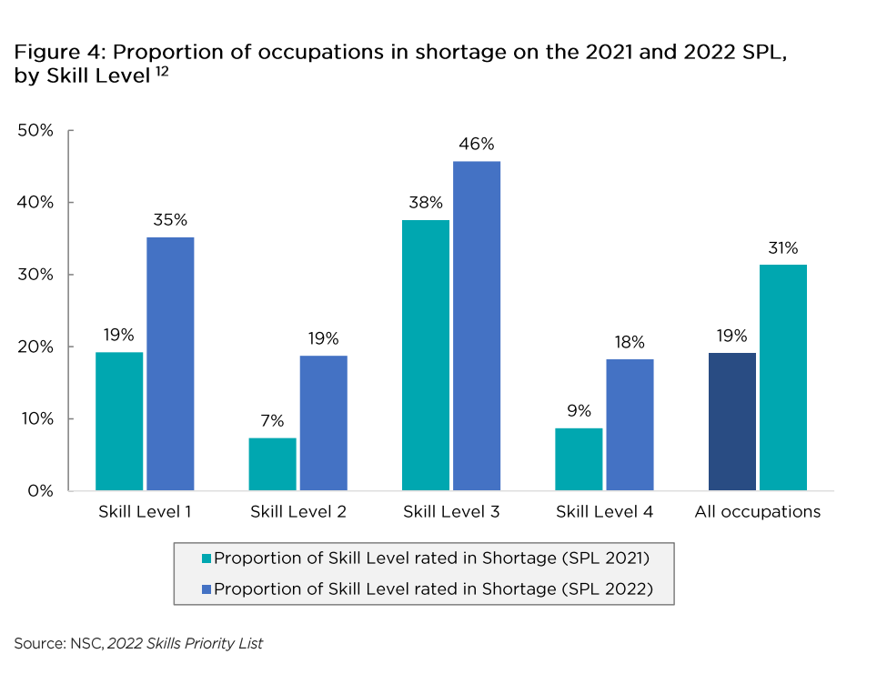

Slide 33
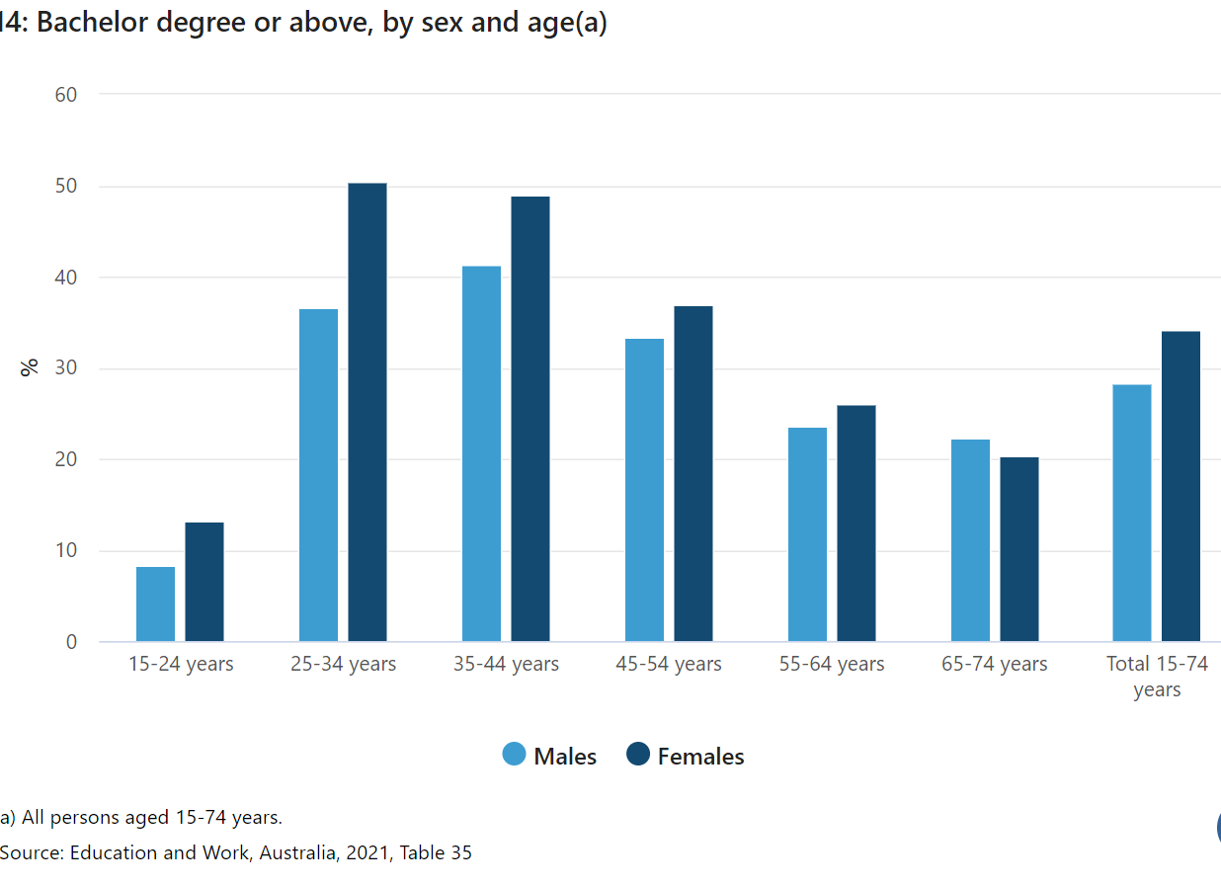

Slide 34
Arguments for Higher Level VET Courses
Taught by practitioners not “just” researchers – better informed by practice
Diversity and choice of providers
Improves access and equity by attracting disadvantaged and non traditional students
Policy “gravity” – historically colleges have become universities. Sydney Technical College to both UNSW and UTS
Raises status and esteem of VET institutions
Faciltates more integrated tertiary education sector

Slide 35
The future – what I suggest
Stability – less day to day political influence
More input by and support for educationalists at all levels
Greater emphasis on core, especially numeracy skills
Realistic funding strategies
Priority for trade, care and foundation courses
Priority for Certificate 3/4 and short courses

