Slide 1
Federation University Australia acknowledges
the Traditional Custodians of the lands and
waters where our campuses, centres and field stations are located and we pay our respects
to Elders past and present. We extend this
respect to all Aboriginal and Torres Strait
Islander and First Nations Peoples.
The Aboriginal Traditional Custodians of the
lands and waters where our campuses,
centres and field stations are located include:
Wimmera | Wotjobaluk, Jaadwa, Jadawadjali, Wergaia, Jupagulk
Ballarat | Wadawurrung
Berwick | Boon Wurrung and Wurundjeri
Gippsland | Gunai Kurnai
Nanya Station | Mutthi Mutthi and Barkindji
Brisbane | Turrbal and Jagera

Slide 2
Principles of Academic Governance
Induction for Academic Board
Professor Bernadine Van Gramberg, Chair, Academic Board
October 2024

Slide 3
REGULATORY ENVIRONMENT
Victorian Government
Federation University
Commonwealth Government
Funding
  Victorian Training Guarantee (VTG)
  VET Funding Contract
Federation University Act 2022
Audit
  Higher Education Skills Group
  Victorian Training Guarantee
Corporate Governance
  Council and Vice-Chancellor
  Strategic planning
  Regulatory framework
  Delegations
  Monitoring systems, controls, Finance
  Management structures
Funding
  Compacts
  Higher Education Support Acts
  Commonwealth Grants Scheme
ESOS Act
  CRICOS
Industry Skills Council
Data
  Surveys and MyUniversity website
Reporting
  Institutional Performance Portfolio
Academic Governance
  Academic Board
  Academic regulations and policies
  Accreditation
  Quality assurance
  HE Standards
VE Standards and Regulator
National VE & Training Regulator Act
  ASQA standards for VET accredited courses 2021
  Standards for RTOs 2015
  Standards for VET Regulators 2015
Regulators
  Australian Skills Quality Agency (ASQA)
  National Regulation & Accreditation
  Victorian Registration & Qualifications Authority (VRQA)
  State Regulation & Accreditation
Quality Framework
  Procedures and processes
  Roles and responsibilities
  Continuous improvement
  Student charter
  Student support
HE Standards and Regulator
Tertiary Education Quality and Standards Agency Act
  HE Standards Threshold Framework 2021
Regulators
  Tertiary Education Quality and Standards Agency (TEQSA)
  National Regulation & Accreditation
Professional Bodies and Registration Authorities
Australian Qualification Framework

Slide 4
University framework
University Governance
Corporate Governance
Academic Governance
Council
Academic Board
Committees
(established by Council)
Committees
(established by Academic Board)
Management
(Vice Chancellor and Staff)
Advisory Committees
(e.g. internal management or advisory committees)
Committees established under external requirements
(e.g. Ethics Committee)

Slide 5
Governance triangle
Responsible for general direction and superintendence of the University.
University
Council
Responsible for the conduct of the University's affairs in all matters.
GOVERNANCE
Responsible for overseeing and monitoring academic activities
Executive
Group
Academic
Board

Slide 6
Federation University Australia Statute 2021
6.0 Objective and functions of the Academic Board
The objective of the Academic Board is to establish and maintain academic leadership at an institutional level.
The functions of the Academic Board are to—
  achieve effective academic oversight of the quality of teaching, learning, research and research training;
  Assess and approved proposed new academic and other proposed new programs leading to an award;
  set and monitor institutional benchmarks for academic quality and outcomes;
  provide advice to management and the Council on academic matters, including advice on academic outcomes, policy and practices;
  monitor and report to the Council on academic and research quality and standards;
  consider issues referred to it by the Council for consideration.

Slide 7
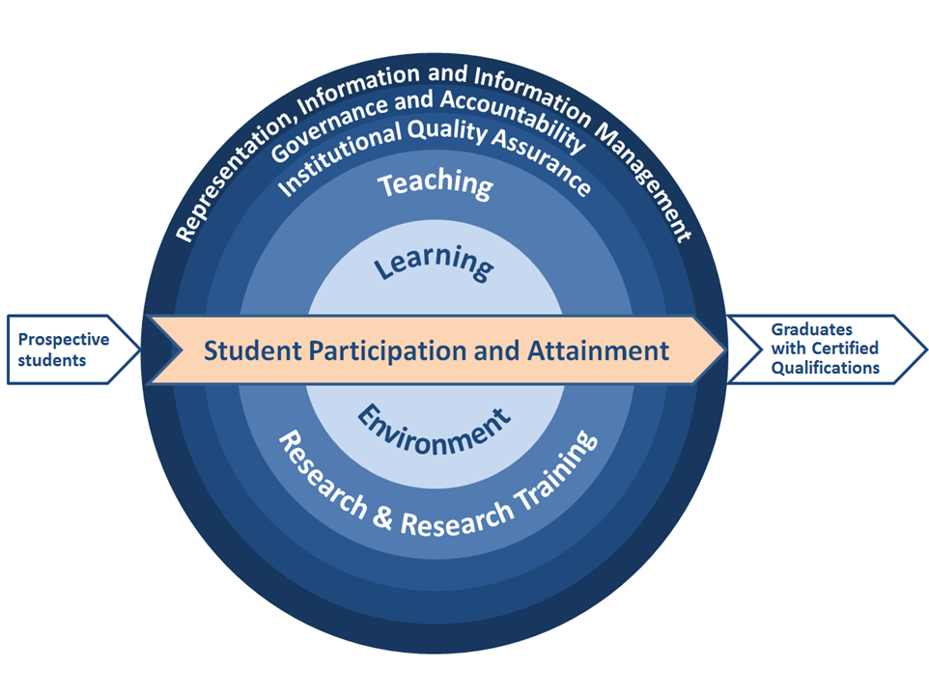
TEQSA HIGHER EDUCATION STANDARDS AT A GLANCE
TEQSA STANDARDS
1 Student Participation and Attainment
1.1.................. Admission
1.2.................. Credit and Recognition of Prior Learning
1.3.................. Orientation and Progression
1.4.................. Learning Outcomes and Assessment
1.5.................. Qualifications and Certification
2 Learning Environment
2.1.................. Facilities and Infrastructure
2.2.................. Diversity and Equity
2.3.................. Wellbeing and Safety
2.4.................. Student Grievances and Complaints
3 Teaching
3.1.................. Course Design
3.2.................. Staffing
3.3.................. Learning Resources and Educational Support
4 Research and Research Training
4.1.................. Research
4.2.................. Research Training
5 Institutional Quality Assurance
5.1.................. Course Approval and Accreditation
5.2.................. Academic and Research Integrity
5.3.................. Monitoring, Review and Improvement
5.4.................. Delivery with Other Parties
6 Governance and Accountability
6.1.................. Corporate Governance
6.2.................. Corporate Monitoring and Accountability
6.3.................. Academic Governance
7 Representation, Information and Information Management
7.1.................. Representation
7.2.................. Information for Prospective and Current Students
7.3.................. Information Management

