Slide 1
The impacts of Work Based Learning for Vulnerable Youth.
“Can’ t expect you to be a professional at it or experienced, you’re not experienced, its “work experience’, ‘work -based learning’ being the key words you are learning.” Kyle p.55 Cheree Macdonald (She / her)
T +61 3 5327 8340
c.macdonald@federation.edu.au
23rd November 2022.
Notes:
What I learnt and the skills I developed in my first experience of the workplace.
Bakery – shy – had to talk all day, country town, people came for the connection and the cream cake.
Year 11 – 40 17 year old's to Melbourne – possibly the model to develop. Coached through the week by our peers and teachers.

Slide 2
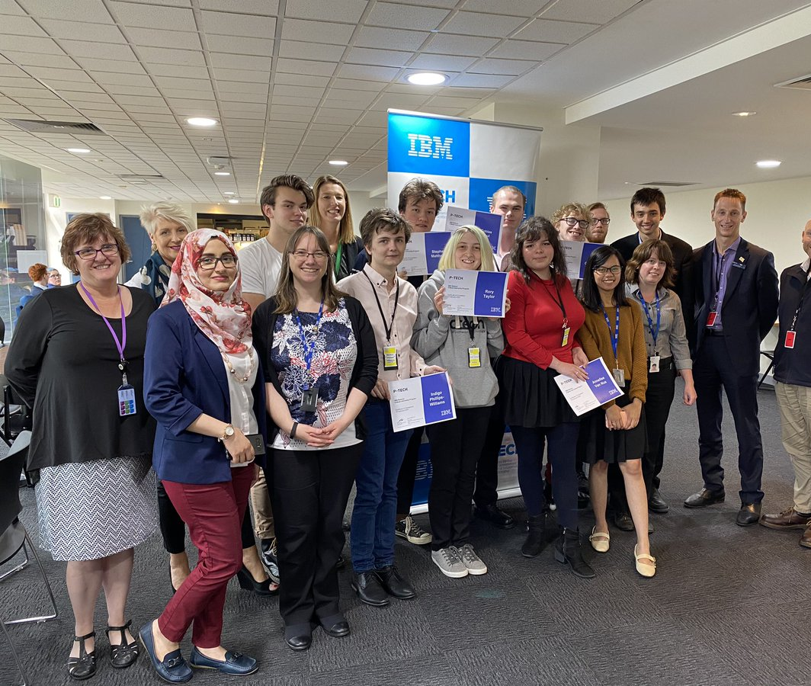
Introduction
10 years in Applied Learning
Importance of education being relevant to the world of work
Industry Led education | Co designed curriculum
Multi sector | Curriculum | Student cohorts
Vulnerable learners | second chance | CALD
Notes:
Education that was relevant to the world of work – worthwhile education – key to engage vulnerable youth.

Slide 3
Contents
Background to the Study
Purpose of the Research
Key Concepts
Methodology
Key Themes
Outcomes
Impact on WBL models
Key messages
Notes:
Outline of presentation – break down

Slide 4
Background to the study
Work Based Learning – recognised as a catalyst for change – how to maximise
Vulnerable students – second chance
Barriers to access opportunities
Notes:
WBL provided a chance for students, teachers and industry to construct the reality of the workplace – deepened the learning and impact.
The classroom only provides two perspectives.

Slide 5
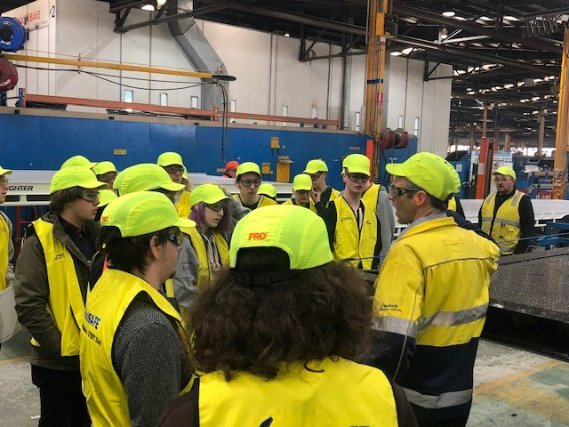
Purpose of the Research
How does WBL impact the education of vulnerable youth involved in vocational education?
How can work-based learning increase student engagement?
What are the positive impacts of WBL?

Slide 6
WBL as a protective factor, that is, a characteristic that reduces the negative impact of a risk factor for vulnerable youth, is cited extensively throughout the research literature (Bailey et al. 2005; Billet, 1995, 2004; Bollie & Hof, 2018; Michalopolous et al, 2000). An example of this might be a disengaged learner (at risk of dropping out of school) completing WBL, which impacts their resilience and aspirations for continuing their education (protective factor) (DeLuca et al., 2008). P.27
Work Based Learning
Work Experience
Structured Workplace Learning
Virtual Work Experience
Industry Connections (site visits, industry panels, co-designed projects)
Placements
Internships
Notes:
Work experience – broaden experiences and understanding
SWL – on the job training mastering a set of skills or competencies
Placement – HE
Internship – paid / unpaid

Slide 7
Vulnerable Learner
Risk Factors | Second Chance Education
Low SES | Detached | disengaged from education
Mental Health, Drugs & Alcohol Family challenges | Left mainstream | home schooled
Learning Challenges | Adult Learning Environment
Unstable Housing | VCAL | VET
Notes:
Student cohort at Federation Youth – VCAL / VET

Slide 8
Methodology
The epistemological approach centred on a constructivist view.
‘Constructivists argue reality is socially constructed by the persons who experience it. In my research this includes the students undertaking WBL, teachers and workplace supervisors (Darlaston-Jones, 2007)’.
Qualitative approach – student voice
Multiple perspective case study – semi structure interview
2 Senior Secondary Students VCAL / VET Student – Fed TAFE
Notes:
Constructivist view – student, workplace supervisors and teachers

Slide 9
WBL Impact on Vulnerable Youth
Increase Student Engagement | Positive Impacts
Supported challenge -Kyle | Protective factor
Workplace provides challenging learning environment - Not all learning is comfortable - Orla | Grit – perseverance – “figuring it out” -Orla
Structured reflections on WBL experiences - reviewing and exploring moments of challenge | Deepen understanding of workplace and pathway
 | Caring teachers – “Love push” - motivation
Notes:
Kyle – needed support to overcome anxiety of making contact and then turning up to the workplace – kept removing barriers
Orla – felt abandoned in the workplace – felt she needed more support – didn’t know what she was doing – but the supervisor gave such positive feedback –she arrived at a deeper understanding and her confidence in herself grew – industry expert said she was competent.

Slide 10
P-TECH (Pathway in Technology)
Recruitment Project | Virtual Work Experience
IBM Recruitment process | Prototype Website
Supported challenge | Subject Matter Experts - Industry
Phone interviews - feedback | SCRUM – Planning and retrospective meetings
Group interviews – feedback | Group retrospective
Job Interview (scaffolded) - feedback | Sandwich feedback
Reflective discussions and reflective journal | Reflective discussions and reflective journal
Notes:
Understanding the impact of feedback and reflection – this was built into newer WBL models.

Slide 11
International Students
Vulnerable | Barriers | Opportunities
Cultural awareness | Employer misconceptions | Identifying values and strengths in career coaching – deliberate practice – share success stories
Communication styles | Work rights | Addressing misconceptions – rebranding as a strength
Visa | Accent | Building retrospective reflections into WBL – what did you learn about yourself – transferable skills
Notes:
International students are vulnerable –
but remove barriers
a have a robust review process and deepen impact and learning.

Slide 12
Outcomes
Student voice provides a different narrative to the at-risk storylines about young people who do not necessarily flourish in a traditional educational setting.
Student voice central to decisions about their education and pathway
Students viewed WBL as a worthwhile experience, which impacted their social maturity, independence and persistence and preparedness for future work
Students who are supported by caring staff, in a WBL program that offers challenge, are capable of developing grit and resilience, particularly when supported by a robust review process.
Structured review process to limit the negative impacts
Notes:
Control your effort – can’t control the outcome
positive and negative impacts are constructed between the people
however the learning can be reviewed and reflected upon to deepen the learning.
Don’t miss the opportunity.

Slide 13
Key messages
Support students and remove barriers to WBL – provides a potential protective factor for vulnerable youth
Create opportunities for reflection – deepen the impact of WBL
Importance of students sharing their views -value student perspective and put it at the centre of decision making in education
Embed structured, critical reflection opportunities post WBL
Notes:
Share the success stories
change the narrative
care enough to remove barriers
and structure the review process.

Slide 14
Further discussions or questions: Cheree Macdonald she/her 03 5327 8340 c.macdonald@federation.edu.au References Bailey, T. R., Hughes K. R., & Moore, David, T. (2005). Working Knowledge: Work Based Learning and Education Reform. United Kingdom: Taylor and Francis e-Library Billet, S. (1995). Workplace learning: its potential and limitations. Education and Training Journal, 37(5), 20-27. Billet, S. (2004). Workplace participatory practices: Conceptualising workplaces as learning environments. Journal of Workplace Learning, 16(6), 312-324. Bolli, T., & Hof, S. (2018). The impact of work- based education on non- cognitive skills. Journal of Research in Personality, 75, 46 -58. doi.org/10.1016/j.jrp.2018.05.005 DeLuca, C., Hutchinson, N.L., deLugt J.S., Beyer, W., Thorton A., Versnel & Munby,H. (2008). Learning in the workplace: Fostering resilience in disengaged youth. 308-319 doi: 10.3233/WOR-2010-1032 Michalopoulos, C, & Schwartz, C. (2000). What Works Best for Whom: Impacts of 20 Welfare-to-Work Programs by Subgroup. Executive Summary. National Office of Welfare-to-Work, 450(275), 2-20.
Notes:
Think, pair, share.
Did someone remove a barrier for you to access WE?
What did you learn about yourself?
How has that affected your approach with students?

