Slide 1
Retail Work: Ubiquitous, Undervalued and Uncertificated?
Journal of VET conference, Oxford, July 13th-15th 2023
Erica Smith and Andy Smith, Federation University
On behalf of the other members of the research team: Victor Callan, Richard Robinson, Darryn Snell.
Project web site https://federation.edu.au/research-everyday-careers

Slide 2

Careers in everyday industries: Potential benefits of increased visibility – research project
Funded by the National Careers Institute (part of Federal Department DEWR)
Project partners
Federation University
University of Queensland
RMIT University
SkillsIQ Skills Service Organisation

Slide 3

Erica’s own retail career history
Student-working at a supermarket.
Personnel Officer with the same company.
Labour market programs at TAFE in retail.
Managed South Australian Wholesale, Retail and Personal Services skills council.
… as well nearly thirty years as VET academic – often researching in retail and hospitality.

Slide 4
Background
Retail is consistently a major industry of employment in advanced economies (Bozkurt & Grugulis, 2011) with multiple career paths in both operational and professional areas.
It is the source of first jobs for over half of Australian young people (three-quarters of those working at age 15) and employs over 10% of all workers.
The industry is nevertheless of low status, as a consequence of social construction of skill (Payne 2009; Warhurst & Knox, 2015) in policy circles and among stakeholder groups. Its perceived feminisation (actually 57%) contributes further to perceptions of low status (Healy et al, 2006).
The low status results in poor self-image for retail workers, low investment by governments in training for the industry, and reluctance among young people to consider careers in the industry despite its ubiquity and accessibility.
Retail became better respected during Covid (Schoon & Mann, 2020; Avis et al, 2021) because of the contribution of its frontline workers and its constant innovations in practice to address health and supply chain issues.

Slide 5
Research questions
What careers are available in the retail and hospitality industries?
What are the perceptions of the following groups of people about available careers in these industries, and how are these perceptions gained?
    workers in the industries;
    young people at school, and university students;
    school staff, and staff in agencies advising adults on careers;
    the general public in Australia.
How could careers in these industries be made more visible, more attractive, and easier to navigate?
What would be the associated benefits, and for whom?
For a summary of the rationale and approach, see video at https://www.dewr.gov.au/nci/partnership-grants-program/case-study-videos

Slide 6
Method for the research project: 264 research participants
Analysis of data from three previous research projects;
Analysis of publicly available data: Australian Bureau of Statistics, National Centre of Vocational Education Research, ‘On Track’ school-leaver data.
Interviews with key stakeholders and experts in the industries and the careers sector;
Academic focus groups in retail and hospitality;
Seven case studies of retail and hospitality companies;
Career practitioners’ survey and matched ‘general public’ survey;
Tertiary student and recent school-leaver focus groups;
International comparisons: interviews with apprenticeship academics and government officials in Germany and Switzerland.

Slide 7
Summary of publicly available statistical data
Almost one million (970,080) Australians work in retail - 10% of the workforce. Almost 1 in 20 workers (500,000) are sales assistants alone.
VET enrolments in retail qualifications were 53,383 in 2017; there were 3.4 million people in VET qualifications in total.
Only 1.6% of VET is provided for this 10% of the workforce.
Most of the enrolments were at the Certificate II (34,357) and the Certificate III (15,826) levels.
There are now very low enrolments in retail apprenticeships (‘traineeships’) as government funding was withdrawn in the early 2010s.
There are no longer any standalone retail management courses at universities.

Slide 8

Jobs: Data from the Longitudinal Surveys of Australian Youth
What data did we use?
What did we find?
LSAY tracks a sample of Australian young people annually from ages 15 to 25. (We used ‘09’ data).
They are asked, each year, if they are working and what their jobs are.
They are asked what jobs they expect to have when they are about 30
Only 3-5% expected to be working in these retail and hospitality jobs when they were 30.
But, many actually worked in these jobs. Of those who worked, the following proportions held:
75% aged 15
50% aged 19
11% aged 25
By age 19, 15% were managers

Slide 9
Careers in Retail: Stakeholder perspectives (Employer organisations, trade unions, skills council)
Entry level remuneration may be low, but it increases quickly with promotion.
Retail careers can be pursued anywhere.
Often CEOs and other senior managers work their way up the retail career pathway from the most junior levels. ‘Trolley boy to CEO’ is a reality.
The overriding factor for success in retail is a passion for working with people – customers and staff alike.
Qualifications are not viewed as important by companies in recruitment decisions or in career development.
Policy makers mistakenly perceive retail work through the lens of their own experiences as student-workers.
Managers moving into retail from outside receive negative feedback from friends and family.

Slide 10
Issues from the three retail case studies:
45 interviewees
A wide variety of roles and diversity of career paths available.
Fast track development – people taking senior roles at a young age.
Strong staff development systems.
Qualifications not highly valued or common amongst staff.
Often recruitment is based on “fit” with the organisation.
Industry not held in high esteem as a long-term career option.
Most staff have experienced negative feedback on their choice to work in retail.

Slide 11
Training in the companies
Very little importance is attached to qualifications in recruitment, or on acquiring qualifications later in the career.
Well developed on-line training systems are ubiquitous in larger companies.
Such training is generally done in one’s own time.
Store managers are often selected on the basis of their ability to identify, develop and train talent.
Frequent use of movement between stores and HQ for development – ‘zig-zagging’.
New roles are developing in on-line retailing.

Slide 12

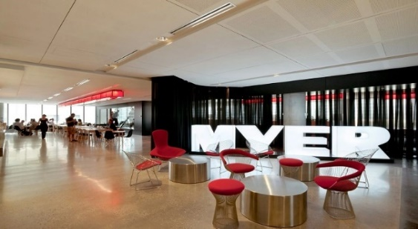
Young managers in retail
In seven company case studies, we found people in management positions at very young ages (in their mid-20s), in stores and in head office jobs.

Slide 13
What do career practitioners think?
  75% of respondents had worked in retail.
  About 60% rated their knowledge of the industry as “medium”.
  Less than 20% rated the industry as having good career prospects.
  45% rated retail as a low prestige industry.
  Over 70% of respondents said that fewer than 20% of their students expressed an interest in retail as a career
  Few could think of former students who had gone on to successful careers in retail
  The level of engagement between schools and local employers was generally, superficial, with no examples quoted of an in-depth, long-term relationship.

Slide 14
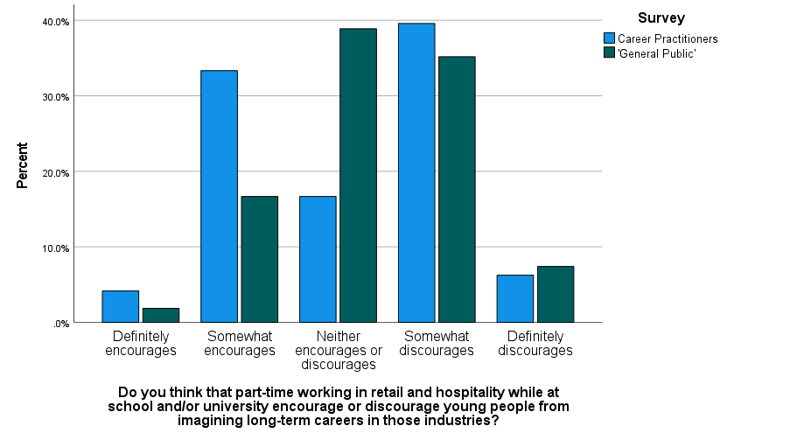
What does the ‘general public’ think?
We carried out a ‘general public’ survey of staff at two dual sector universities. 59 responses. As far as appropriate, we duplicated the questions from the career practitioner survey.
We are analysing the comparative data: an example is on the right.
In general the views of career practitioners are fairly similar to others who might be ‘career influencers’.

Slide 15
What do young people think?
Because of Covid we were prevented from accessing young people in schools. Instead we interviewed young people
In first year at university, as recent school-leavers.
Studying business at university and TAFE
The young people we interviewed generally had ambitions for careers in other industries, although most had worked in retail and many in hospitality. They appreciated the transferable skills they learned. They had sometimes experienced poor working conditions. They were generally unaware of career possibilities.

Slide 16
Impact of Covid mentioned by case study interviewees
Food retail was one of the few sectors to remain operational during the Covid lockdowns.
Retail workers were hailed as “essential workers” by the Prime Minister.
There was a major, and to some extent continuing, switch to on-line retailing.
Retail workers often faced significant customer hostility.
Many families had members going out to work whilst others stayed at home, creating family tensions.

Slide 17
Social construction theory
The relative prestige and worth of a job/occupation is determined by some key markers, e.g.:
  Level and amount of formal education specified for the job;
  Pay levels compared to other jobs;
  Availability of career pathways;
  Gender composition of the workforce.
Retail actually ‘scores well’ on most of these indicators except levels of formal education.

Slide 18
So, what is the problem? Is it an industry hiding in plain sight?
Quotidian nature of the industry – many people visit retail sites almost daily.
What people see – primarily young people working on the shop floor.
Managers often look no different from other workers and are often young.
Many people have themselves worked on the shop floor, and remember this as being what retail work is.
Most retail occupations are hidden from public sight, in stores and in distribution centres and head offices.

Slide 19
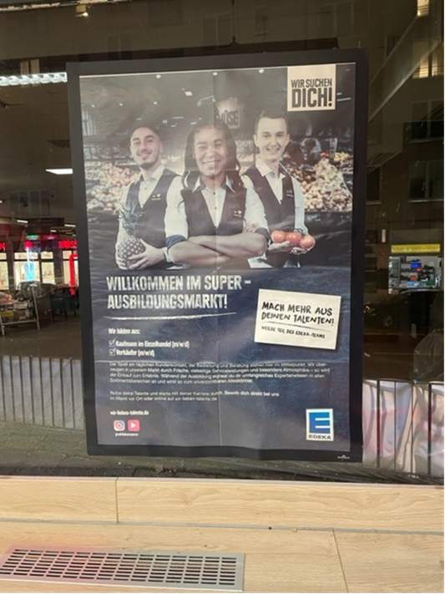
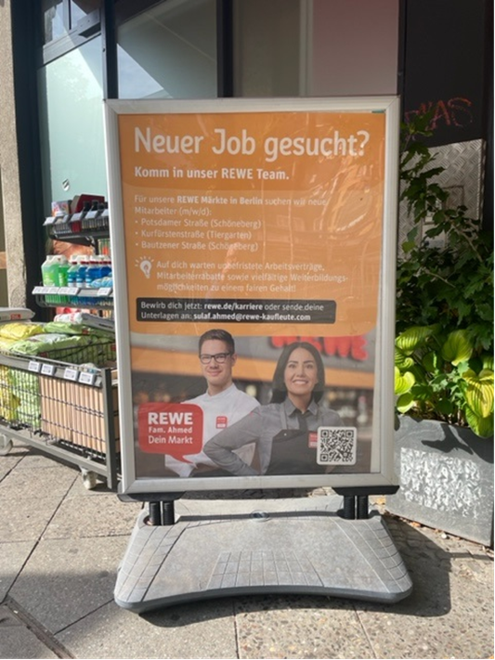
International comparison: Edeka and Rewe supermarkets (Germany)

Slide 20
Germany: Qualifications Retail and Trade (Mottweiler & Milolaza, 2022)(BiBB)
GQF / EQF level 3 | GQF / EQF level 4 | GQF / EQF level 5 | GQF / EQF level 6 | GQF / EQF level 7
Initial vocational education and training |  | Further vocational education and training – higher education
Dual degree programms: integrating regarding training, expierience and occupations, part time
Management assistant for retail services
Consultants for example for wine, constructional, do-it-yourself demand and other sections of goods*
Bachelor of
(international)
Retail Management
Master of
(international)
Retail Management
Wholesale and foreign trade clerk - specializing in wholesale or foreign trade
Bachelor of Arts
Retail and Distribution
Master of Marketing and Sales
Management assistant for e-commerce
Certified commercial specialist
Master Professional in Business Management according to the Vocational Training Act
Further professions in the trade sector: :
Salesperson specialising in foodstuffs, Chemist,
Automobile business administrator, Bookseller, Specialist retail assistant for the music branch
Certified specialist for Retail Sales
Certified international business manager / Bachelor Professional in foreign trade
Sales assistant for retail services
Certified business administrator for e-commerce
*= these qualifications have not yet been officially allocated to the GQF level 5

Slide 21




Guy Parmelin
Minister for Education, Economic Affairs and Research
High school
Apprenticeship in agriculture
Federal Diploma in HE
in agriculture/vinemaking
>20 years work in agriculture
Philipp Wyss
CEO Coop
Apprenticeship as commercial employee
Apprenticeship as butcher
>20 years work in retail
(Swars, 2023)

Slide 22
Towards a new theory
Retail industry is under-recognised by the public and career influencers;
It is undervalued by potential employees, the public, and by staff in the industry;
It is uncertificated, with very low levels of formal training.
But:
Retail is one of the largest employing sectors in the Australian economy;
It proved to be an “essential” industry in the pandemic;
It offers a wide range of good jobs and career pathways.
Issues:
Retail does not have many identifiable ‘occupations’, thus reducing career aspiration;
There are large and largely unrecognised internal labour markets in the major companies;
The prevalence of young people downgrades the reputation of retail, despite the nod given to the development of generic and customer service skills;
The retail industry does not promote itself sufficiently, perhaps internalizing such prejudices.

Slide 23
Among project outputs: Recommendations that we made for retail companies
Businesses need to find new ways of marketing for recruitment.
Businesses need to promote and market the diversity of careers available.
Businesses should explain the significant opportunities for development and promotion.
Businesses need to acknowledge and address industry practices which may be contributing to ‘image problems’.
Businesses need to increase their use of qualifications-based training.
Businesses must promote a modern and contemporary outlook.
Businesses need to work much more closely with schools and career practitioners.
Businesses need to work with universities.
Businesses should highlight the opportunities for working with people.

Slide 24
Recommendations that we made for policy makers
Policy makers must work more closely with the retail and hospitality industries to improve public perceptions about the industries and market the industries more effectively for employment prospects.
Public perceptions continue to be negatively influenced by persistent cultural and structural issues in both industries.. These must be consciously countered.
Governments must support appropriate actions taken by the industries to recover from the closures and major job losses during the Covid 19 pandemic.
Policy makers should consider highlighting the benefits of working in the retail and hospitality sectors, such as long-term career paths and rewards via websites and in careers literature.
In pronouncements and publicity about jobs and training. Governments should use depictions of, and stories from, retail and hospitality.
Policy makers in the jobs, skills and training fields need to inform themselves about the industries
There is a need for review of the formal training and education arrangements (VET & HE) for these industries.
Commonwealth and state governments should restore appropriate funding for retail and hospitality qualifications,
Classifications on ANZSCO (the Australian Bureau of Statistics occupational classification) need improving to better recognise job roles within these industries.
Steps are required by Government to support these industries to develop better workforce strategies.

Slide 25
Acknowledgements
Thank you to:
the other three researchers on the project: Victor Callan and Richard Robinson (UQ) and Darryl Snell (RMIT).
the four retail, two hospitality and one fast food (quick service restaurant) company which agreed to participate.
our project reference group and critical friends.
the overseas interviewees.
all of the interviewees and survey respondents.

Slide 26
Contacts - and the answer to the question we set you
We welcome comments and queries: e.smith@federation.edu.au
The project webpage is https://federation.edu.au/research-everyday-careers
The salary of a manager of an average size supermarket is around $120,000. ($80,000 US; 72,000 Euros; 62,000 GBP)

