Slide 1
Career practitioners’ views of careers in retail and hospitality
Erica Smith e.smith@federation.edu.au and Andy Smith andy.smith@federation.edu.au
Presentation for OctoberVET 23.11.22
Other project team members: Victor Callan (University of Queensland - UQ), Richard Robinson (UQ) and Darryn Snell (RMIT University).
Research assistants involved with this presentation: Adrian Marshall, Neroli Sawyer.

Slide 2

Careers in everyday industries: Potential benefits of increased visibility – research project
Funded by the National Careers Institute (part of Federal Department DEWR)
Project partners
Federation University
University of Queensland
RMIT University
SkillsIQ (Skills Service Organisation)
Project managed by Professor Erica Smith, Fed Uni.

Slide 3
What are we investigating?
In-depth research in retail and hospitality industries to better understand available careers, and perceptions held about career prospects.
To find ways in which these perceptions can be improved.
To work towards better career choices, especially for young people, and better career prospects in the industries.
Funded by the National Careers Institute.
The project began in April 2021 and finishes in early 2023.

Slide 4



Background
Rationale for the project
Retail and hospitality industries employ around 20 per cent of the Australian workforce, operating throughout Australia, yet the industries suffer from low prestige.
This historically low perception discourages people from imagining worthwhile careers in those sectors, and can contribute to poor self-image for those working in the industries.
Yet the COVID-19 crisis has shown just how vital both of these sectors are for the Australian public and the national economy.
They are recognised internationally, for example by the OECD, as low-status occupations which have become more valued during the crisis.

Slide 5
What is the problem?
Industries often perceived as low skill;
Perceptions reinforced by low levels of qualifications uptake;
Not seen as university graduate destinations;
Seen as “female” industries and therefore less significant;
Impacts on pay and conditions, and perceptions of pay and conditions in the industries;
“The thing you do before the thing you want to do”.
We had discovered all of the above in previous research projects, and we wanted to do something about it!

Slide 6
Research questions
What careers are available in the retail and hospitality industries?
What are the perceptions of the following groups of people about available careers in these industries, and how are these perceptions gained?
    workers in the industries;
    young people at school, and university students;
    school staff, and staff in agencies advising adults on careers;
    the general public in Australia.
How could careers in these industries be made more visible, more attractive, and easier to navigate?
What would be the associated benefits, and for whom?

Slide 7
Method – all phases now completed
Analysis of data from three previous research projects;
Analysis of Australian Bureau of Statistics, National Centre of Vocational Education Research, ‘On Track’ (school-leaver data from the State of Victoria);
Interviews with key stakeholders and experts in the industries and the careers sector;
Seven case studies of retail and hospitality companies;
Career practitioners’ survey and matched ‘general public’ survey;
Tertiary student and recent school-leaver focus groups;
International comparisons (Switzerland and Germany).

Slide 8
Preliminary phase from national data (presented in detail at OctoberVET 2021)
Even taking ‘main job’ only, 15% of workers are in retail and hospitality-specific occupations.
40% more work in retail than hospitality. Almost 1 in 20 workers are sales assistants alone. But four times as many are trained in hospitality.
VET enrolments in hospitality and retail (20%) qualifications were 263,761 in 2017; there were 3.4 million in VET qualifications in total.
Only 7.75% of VET is provided for 15.50% of the workforce
Five people per 100 employed in retail were being trained
31 people per 100 employed in hospitality were being trained

Slide 9
Some key findings from stakeholder interviews and company case studies
There is a very wide variety of career paths open to staff in both industries – especially in retail.
Young people can rise very quickly through the management ranks in both industries.
Young people (early-mid 20s) can achieve high levels of responsibility and earn high salaries unlike many other industry areas.
These facts are not well-known to the general public.
Public perceptions of both industries may have worsened as a result of the Covid pandemic.

Slide 10


Young managers in retail and hospitality
In seven company case studies, we have found people in management positions at very young ages (in their mid-20s), in stores and in head office jobs.

Slide 11
Career Practitioners’ Survey
Administered to career practitioners in a range of organisations – school, TAFE, University. 54 responses.
35 worked in schools and 19 in other settings.
The characteristics of the respondents matches those of a much large survey carried out by CICA (Career Industry Council of Australia)
Survey sections:
Your personal experience of the Retail & Fast-food Industry
Your personal experience of the Retail Industry
Your personal understanding of the Retail Industry
Your personal experience of the Hospitality Industry
Your personal understanding of the Hospitality Industry
Students' and/or clients' knowledge and experience in the industries
Opportunities, training, and careers in the industries
COVID-19 pandemic
Qualitative questions

Slide 12
Some key findings
  75% of respondents had worked in retail; 58% had worked in hospitality – usually as school or tertiary students.
  About 60% rated their knowledge of the industries as “medium”.
  Over 70% underestimated the salary of a supermarket manager* (Answer at end).
  Nearly 60% underestimated the salary of a fine dining restaurant manager
  Less than 20% rated the industries as having good career prospects.
  45% rated retail as a low prestige industry; 22% for hospitality.

Slide 13
How do career practitioners access information about careers in the industries?
Retail
Hospitality
84.3% Web sites such as MyFuture
64.7% interaction with local employers
47.0% reading
45.1% careers expos
41.2% family and friends
78.0% Web site such as MyFuture
64.% interaction with local employers
52.0% reading
50.0% careers expos
38.0% family and friends

Slide 14
Approx. what proportion of your own students profess an interest in a career in the industries?
Retail
Hospitality
Less than 20%: 72.9%
21-40%: 10.42%
41-60%: 6.25%
More than 60%: 4.1%
…. What are the implications?
Less than 20%: 62.5%
21-40%: 20.83%
41-60%: 14.58%
More than 60%: 0%
…. What are the implications?

Slide 15
Seeking career practitioner views about the industries
The survey asked four questions that involved a qualitative commentary.
On average, 20 responses to each question were provided by secondary school careers practitioners out of 35 overall school respondents.
On average, responses were received from only 4 of the other 19 career practitioners.
This disparity has two implications:
From the analysis point of view, the responses must be seen as strongly reflecting the views of school career practitioners.
It suggests that non-school career practitioners may be less engaged with the common industries of employment, or, perhaps more controversially, that they are less interested.

Slide 16
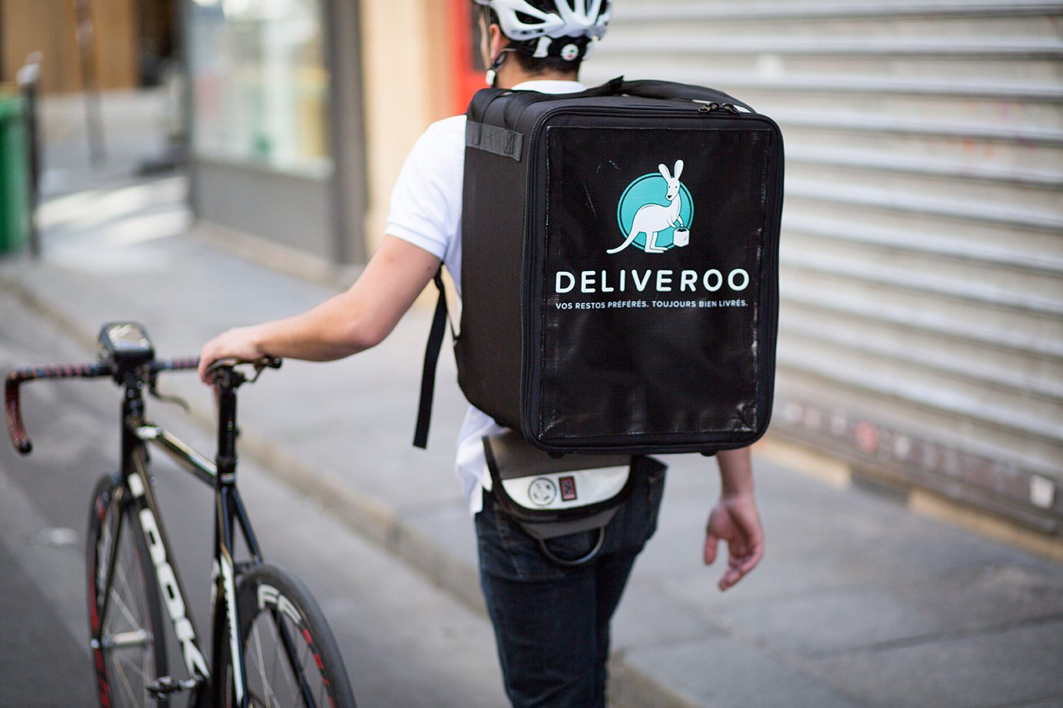
New roles
Q. What are some of the new roles, do you think, that have grown out of the pandemic in these industries?
The responses to this question mostly focused on the retail industry and emphasised the emergence of new roles to support on-line retail.
In the hospitality industry the emphasis was on the emergence of home delivery.

Slide 17
Good news stories
Q. Do you have an example of an ex-student/client who has gone on to have a long-term career in retail or hospitality? If so, pleases provide details in the box below.
There were a number of very good examples given of successful careers in both industries.
There were many more in the hospitality than the retail sector.
These careers usually involved students having trained as chefs and then moving on to start up restaurants and cafes of their own, both in Australia and overseas.
Q. In the box below please record up to two examples of good engagement of your organisation with the retail or hospitality industry.
Here the responses covered both industries and emphasised the importance of work experience and as well as traineeships.
The respondents seemed to think that successful work experience is important to changing perceptions about the industries. However, the level of engagement between the organisations, mostly schools, and local employers seemed rather superficial with no examples quoted of an in-depth, long-term relationship.

Slide 18
Q. Finally, what advice would you give a retail or hospitality manager or corporate staff about attracting people to their industries?
The responses, for both industries, emphasised the need for more effective marketing of career prospects by employers and using examples of those who have enjoyed successful careers.
However, some of the respondents also said that their students have a poor perception of working in both industries because of views about pay and conditions. Two examples :
The perception of students is that retail and hospitality jobs do not pay well, there is no career progression and that it is not a well-regarded career in the community. The hours are hard and long - you never get Christmas holidays, expected to work overtime, and you get abused by customers e.g., media/ Covid examples ... and are not supported by management - if you work for a large company. Stories in media exacerbate this perception.
As a careers practitioner and a parent of a young person working in the industry, I can say that many are discouraged from making retail or hospitality a long-term career choice because of the way they are sometimes treated. These can be high stress industries with performance measures in place, such as targets for timed tasks. While this is understandable it doesn't always give young people a view that these are nurturing industries. Many young people are managed by those not much older than themselves who can sometimes lack the interpersonal skills to encourage improved performance in a positive way as opposed to those who can make workers feel discouraged.
So, the challenge for employers is how to manage the long and/or antisocial opening hours and consequent reliance on student and other part-time labour without adverse consequences.

Slide 19
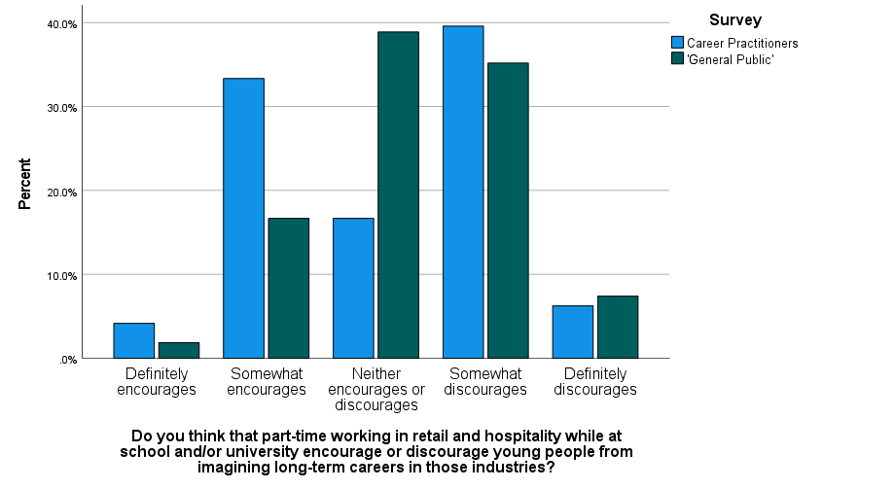
The next phase of survey analysis
We carried out a ‘general public’ survey of staff at two dual sector universities. 59 responses.
As far as appropriate, we duplicated the questions.
We are currently analysing the comparative data: an example is n the right.
This will enable us to compare the views of career practitioners with others who might be ‘career influencers’.

Slide 20
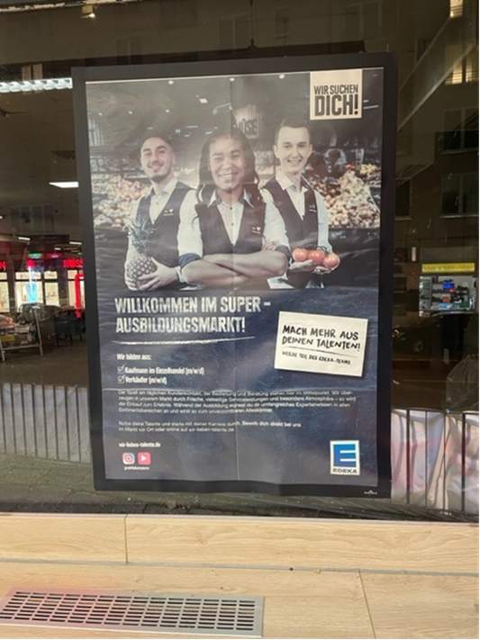
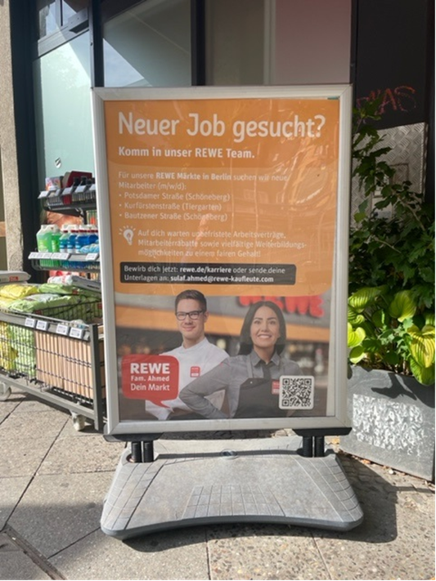
International phase – Germany and Switzerland

Slide 21
* What’s the answer?
The salary of a manager of an average size supermarket is around $120,000.

Slide 22
What’s next?
Analysis of project data.
‘Bonus’ data – the effects of Covid and of post-Covid labour shortages on the industries.
Outputs, by end of February 2023:
A short overview report of the project findings,
Targeted ‘at a glance’ documents for the five identified beneficiaries/stakeholder groups:
the Australian public, at all stages of their careers
careers advisers,
career influencers,
employers,
policy makers.
The research project web site is at http://federation.edu.au/schools/school-of-education/research/research-groups/rave-researching-adult-and-vocational-education

