Slide 1
ARC Discovery DP21 Application process 2019/20
Research Funding Team
Research Services
24th Oct 2019

Slide 2
ARC & NHMRC application & review process 2019/20
The reasons for undergoing both the EOI and application review procedures are:
To ensure that applicants are provided with appropriate support to develop their applications.
To ensure that applications are reviewed so that, if they are to be submitted, they are of a competitive quality.
To ensure that the researcher and university’s reputation is not compromised by the submission of non-competitive applications, nor that undue time is spent on developing applications that are unlikely to be assessed as competitive.
It is important to emphasise that before going to either the external reviewer or the internal reviewer, all ARC and NHMRC applications will have been reviewed by at least two peer reviewers, and will be in a completed draft stage.
And so you can collect choc frogs along the way!

Slide 3
Administration Timelines for DP21 For Internally Administered Applications
Due Date |  | Milestone
Discovery DP21 | DECRA DE21
18 July 19 (12noon) | 18 July 19 (12noon) | Completed EOI and supporting documentation submitted to research.funding@federation.edu.au (one week turnaround)
08 Aug 19 | 08 Aug 19 | Applicants advised of approval to develop application
Sept 19 | Sept 19 | Grant Guidelines released on GrantConnect
24 Oct 19 | 24 Oct 19 | ARC Discovery DP21 and DE21 Workshop compulsory for applicants
TODAY!!

Slide 4
Administration Timelines (cont.)
Due Date |  | Milestone
Discovery DP21 | DECRA DE21
Oct-Nov | Oct-Nov | Budget Proforma now available
July-Oct | July-Oct | Peer-reviewers: Lead CI to send draft application to 2 x Peer-reviewers for feedback (as per EoI).
13 Nov 19 | 02 Oct 19 | Project Applications open on RMS / RGMS
18 Dec 19 (12 noon) | n/a | External Review: ARC: Submission-ready draft (Word or PDF) submitted directly to Prof Peter Baverstock at peter.baverstock@scu.edu.au cc research.funding@federation.edu.au NHMRC TBA
15 Jan 20 (and ongoing) | n/a | External Reviewer returns feedback to applicant with a cc to research funding. **Please aim for as many reviews as possible right up to Final Internal Submission

Slide 5
Administration Timelines (cont.)
Due Date |  | Milestone
Discovery DP21 | DECRA DE21
29 Jan 20 (12noon) | 13 Feb 20 (12noon) | Internal Compliance and Budget Review: Submission-ready draft application (RMS pdf) and finalised budget inc. Budget Proforma (ARC only). submitted to research.funding@federation.edu.au for compliance and budget review
5 Feb 20 | 20 Feb 20 | Compliance and Budget review returned to researcher
12 Feb 20 | 27 Feb 20 | ARC Request not to Assess Close NHMRC RGMS minimum data deadline

Slide 6
Administration Timelines (cont.)
Due Date |  | Milestone
Discovery DP21 | DECRA DE21
19 Feb 20 (12noon) | 05 Mar 20 (12noon) | Final Internal Submission: Submission-ready Final Application, Funding Submission Coversheet (FSC) and ‘DP21 – DE21 Certification Form(s)’ / ‘NHMRC endorsement emails’ submitted to research.funding@federation.edu.au
Research Funding Team final check; arrange for DVCRI approval and sign off; System Certification of final application
26 Feb 20 | 12 Mar 20 | Application submitted to ARC / NHMRC by Research Funding Team

Slide 7
ARC FedUni internal forms and templates
REQUIRED for DP21
ARC & NHMRC Grant EOI – done
DP21 Costing Pro Forma For assistance contact Tara Harle, via research.funding@federation.edu.au https://federation.edu.au/staff/business-and-communication/finance-at-feduni/finance
ARC DP21 Certification & CoI Form (FedUni version) – available soon… https://federation.edu.au/research/support-for-students-and-staff/research-funding/important-funding-application-dates/arc-and-nhmrc-due-dates/funding-rules,-instructions-to-applicants-and-other-relevant-docs
Funding Submission Coversheet (FSC) https://federation.edu.au/research/support-for-students-and-staff/research-funding/grants-forms/step-3-funding-submission-coversheet-fsc

Slide 8
Applying for ARC funding
Be prepared:
Register and set up alerts on GrantConnect
Download and read the Grant Guidelines, Instructions to Applicants (ITAs), FAQs, Funding Agreement, etc
Check cross scheme eligibility https://www.arc.gov.au/grants/grant-application/eligibility-matters
Update your RMS account (all sections), link your ORCID and outputs
Get co-CIs and Partner Investigators (PIs) on board early
They also need RMS accounts - this can be time consuming to manage
Provide them with all documentation
Regular catch-ups with your partners, peers, mentors
Draft, draft and redraft.
Take on board feedback
including previous Assessor Reports if applicable
Make friends with the Research Funding Team ☺
Did I mention read the guidelines??

Slide 9
Applying for ARC funding
Other things to do/consider:
Does your project involve Medical Research? – eligibility issue
Check ARC Medical Research Policy https://www.arc.gov.au/policies-strategies/policy/arc-medical-research-policy/arc-medical-research-policy-version-20181
Request not to assess
Not to be taken lightly; must be justified with comprehensive evidence
let us know as soon as possible
Perceived, potential or actual conflict of interest
All persons and organisations named on the application must declare CoI to Admin Org
Let us know as soon as possible
Did I mention read the guidelines??

Slide 10
GrantConnect www.grants.gov.au Aust. Govt’s whole-of-government, centralised, web-based, grant information system
The ARC no longer publish Grant Guidelines (formally Funding Rules) on their website
Sign in or Create account to access all relevant documentation for Grant Opportunities
Create a User Registration account https://www.grants.gov.au/?event=public.registereduser.new
You can choose to be automatically notified via email of any changes or addenda added to the Grant Opportunity
Continue to use ARC’s RMS to prepare and submit research proposal, rejoinders and reports.

Slide 11
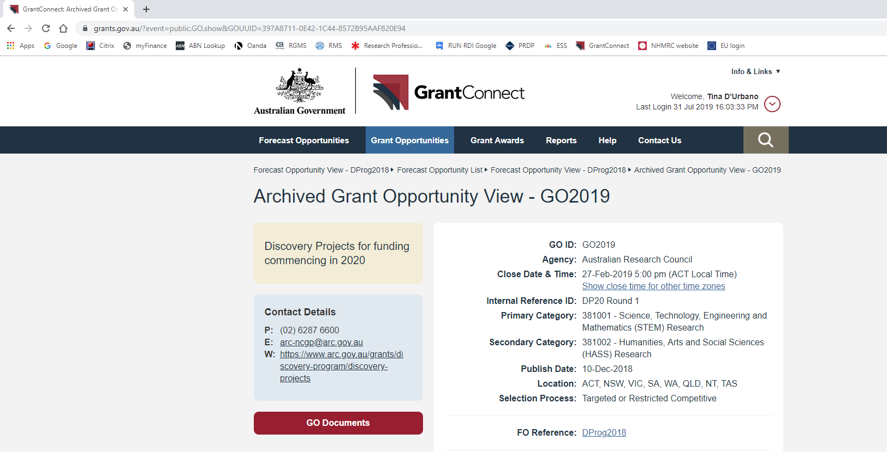
Accessing ARC Grant Guidelines on GrantConnect
https://www.arc.gov.au/grants/grantconnect-australian-governments-grant-information-system

Slide 12
RMS (Research Management System) Essentials
If you haven’t already, ‘Request New Account’ at https://rms.arc.gov.au/RMS/ActionCentre/Account/Login?ReturnUrl=%2fRMS%2fActionCentre%2f
Make sure your Personal Details are complete and up to date
Check the basics are entered and correct such as name, email, phone, DoB and citizenship
Your Admin Organisation MUST be Federation University Australia
Link your ORCID
Expertise Text and FoR Codes – pre-filled into your application
Research Outputs – import your outputs from ORCID – pre-filled into your application
Takes time, do it soon. Ask if you need assistance
Enter/update Qualifications and Employment – pre-filled into your application
Current ARC Projects – should be pre-filled by RMS.
If your current ARC projects do not appear here, please contact us

Slide 13
General Information for Discovery Projects DP21 Parts 1-14 and E of the Guidelines
Must have at least one Chief Investigator (CI) – first named CI is Project Leader
Employed at least 0.2FTE or hold Honorary Academic Appt for grant activity period
You can be a CI on a max. of 2 Discovery Projects at the closing date
Level of funding for DPs – Min $30,000 per year, Max $500,000 per year
Can apply for up to 5 years – must request funding in all years of the project
Teaching relief up to $50,000 per year per CI
Travel up to $50,000 over the life of the project (excludes Field Research or carer’s costs)

Slide 14
General Information for DECRA DE21 Parts 1-14 and C of the Guidelines
Must nominate one DECRA Candidate (CI)
PhD conferred on or after 1 March 2015 (or commensurate Career Interruption)
Employed for the duration of the project: Minimum of 0.8FTE on research activities Expected a minimum of 0.2FTE on Admin. Org activities inc. teaching 3 years full-time or a part-time basis not exceeding 6 years
Salary funding for DEs – $104,316 (2019 rate) per yr plus up to $50,000 project funding per yr Project funding maximum increased by $10k since last year
Travel – up to $50,000 over the life of the project (excludes Field Research and Carers costs)
Up to 1 HDR stipend per proposal

Slide 15
Main Changes to the Discovery Guidelines (DP21)
Multi-year guidelines – Specifics such as ‘DP21’ and dates removed. See ARC website instead for this information
Streamlined formatting – Whole of govt. guidelines template
Changes to assessment – Nothing major for DP21. A few sub-elements of assessment criteria have been moved around (see changes document for details). This will probably be reflected in the DP21 application on RMS.
Teaching Relief – Per CI instead of per project (i.e., $50k per CI, per yr)
Removed Discovery International Award (DIA) – To ease admin. burden. Seek funding under travel, etc instead.
Set Start Date – DP Grant Agreement now has a set start date to avoid confusion. This will be 12 months after the ‘Grant Commencement Date’.
Data Management Plan – Removed from application. This will now required post award.

Slide 16
Completing the DP application Based on DP20 Instructions To Applicants
Carefully consider
Working Title (~10 words)
Application Summary – very prescriptive, follow the instructions
National Interest Test (NIT) Statement - ‘Outline the extent to which the research contributes to Australia’s national interest through its potential to have….benefits to the Australian community.’
FoR and SEO Codes – choose appropriately and strategically

Slide 17
Completing the DP application (cont.) Based on DP20 Instructions To Applicants
Carefully consider
Part D ROPE - very prescriptive, follow the instructions
All co CIs and PIs must complete this section
It’s big and time consuming, plan ahead and make sure your co CIs and PIs understand their requirements
Part E Budget and Part F Justification
Must be accurate and justified. Poorly justified items will be cut from your budget.
What are the schools in-kind and cash contributions to the project? This must be approved by your Dean upfront.
Part G Other Research Support (ARC and other) – Straight forward, but a lot of people get it wrong. Follow the instructions carefully and use the template table

Slide 18
Other Participants – Co CIs and PIs
Give them all documentation including the Guidelines, ITAs, FAQs and Grant Agreement
Point out sections most relevant to them
RMS accounts – All participants must have an active and up to date RMS account
Get your other participants onto this early (soon!)
What are their contributions?
There are no partner cash contributions for a Discovery
What are their in-kind contributions? At a minimum, they are providing time.
ARC DP21 Certification & CoI Form – All participants must complete before submission
Tell them early
If awarded – we will arrange a Multi-Institutional Agreement with your external co CIs and PIs
Other Australian universities are across this, but international universities and other partner orgs need a heads-up.

Slide 19
Top 10 common mistakes and omissions From an administrator/compliance perspective
Writing is unclear and long-winded. Grantsmanship not up to par. Keep it clear, concise and well organised. What are you planning to do, why is it important, and how do you plan to achieve this?
Spelling and grammar check and proof reading. Use Aust. English spelling
Be careful about using jargon and technical terms – anyone should be able to read the proposal and have an idea of what you are trying to achieve
Format requirements - Font sizes, margins, page limits
Colour and small diagrams, graphs, etc – allowable but be careful. These must be readable
Part D (DP20) – Personnel and ROPE – All participants must follow the current ITAs
Part E (DP20) – Project Cost (Budget) – Take the time to get the right figures in the right sections
Part F (DP20) – Budget Justification – cash contributions?
Part G (DP20) – Research Support
Timely submission – final draft for review, Certification Forms, Internal Forms – FSC, Budget Pro-forma

Slide 20
Before you start - PLEASE
Grant Guidelines (Part 1-14 + E for DP21)
Read: Instructions to Applicants (ITAs)
FAQs (occasionally updated – register on GrantConnect for email notifications)
Grant Agreement
All documentation changes from year to year. Make sure you are using the latest versions.
Pay close attention to the selection criteria and weightings.
Make contact with your peers, mentors and reviewers Discuss your project with them. Set up times for them to review your proposal
And get written evidence/confirmation of cash contributions (external and internal)

Slide 21
Questions? Contact us
Research Funding Team (RFT): research.funding@federation.edu.au
FedUni ARC contacts in RFT:
Tina D’Urbano Team Leader, Research Funding – 5122 6872
Jane Eltringham Coordinator, Research Funding – 5327 6735
Tara Harle Senior Research and Revenue Officer – 5122 6360
Please direct all ARC related queries to us (RFT). The ARC does not respond to queries from individual participants.

