Slide 1
ARC And Discovery (DP19) Workshop
October 2017
Office of Deputy Vice-Chancellor (Research & Innovation)
Leigh Sullivan

Slide 2
      Prof. Leigh Sullivan - 1.00 pm to 2.00 pm
Brief introduction and overview
ARC assessment process
Hints for successful applications
Continuous Linkage Rounds
DECRA
Questions

Slide 3
      Emeritus Professor Peter Baverstock -
      2.00 to 3.00 pm
Brief overview of DP scheme
DP tips and common mistakes
Proposal sections and assessment criteria

Slide 4
Tina D’Urbano & Jane Eltringham
(Research Funding) – 3.00 to 4.00 pm
Internal Dates and Process for DP19 (2017/18)
Administration tips
Funding Rules changes
Instructions to Applicants (ITAs)
Certification Form
Budget, justification and costing proforma

Slide 5
The ARC Assessment Process

Slide 6
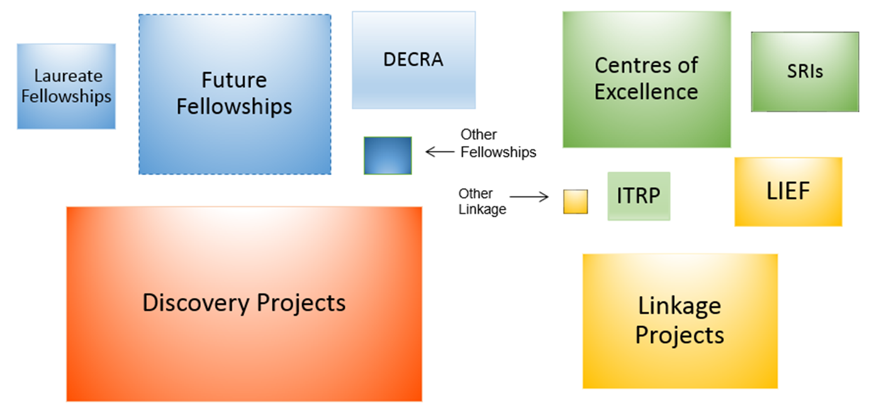
National Competitive Grants Programme
Discovery Programme
Linkage Programme
Area of box represents funding over the period 2011–2015.
N.B. - Centres of Excellence, SRIs, not awarded in every year.
- ITRP and DECRA only funding since 2012

Slide 7
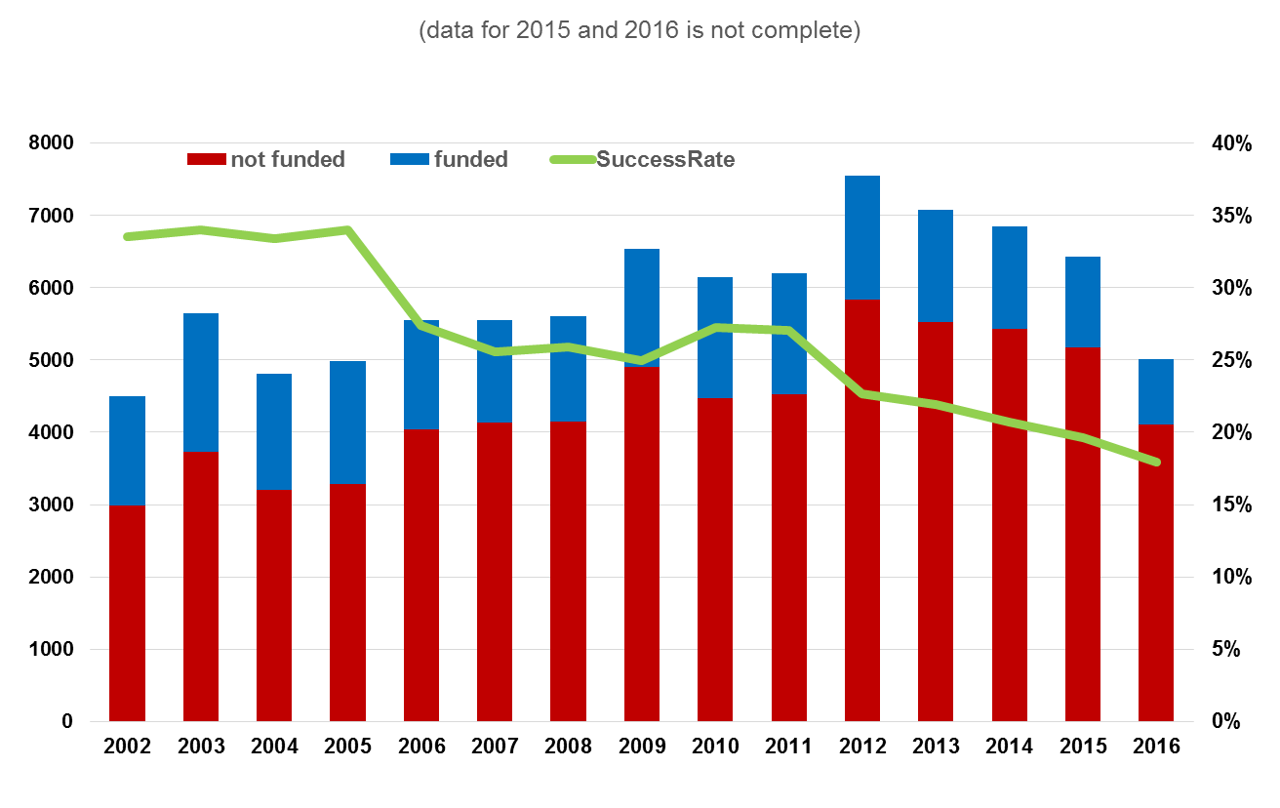
NCGP Success Rates—all schemes and disciplines

Slide 8
Final application sent to Research Services by due date
Application submitted to ARC by Office of Research via RMS system
ARC Executive Director assigns application to 2 members of the College of Experts (COE)

Slide 9
College of Experts DP Panels
176 members of the ARC College of Experts at present.
Arranged in 5 panels for DP selection rounds
Biological Sciences and Biotech
Engineering, Maths and Informatics
Humanities and Creative Arts
Physics, Chemistry, and Earth Sciences,
Social, Behavioural, and Economic Sciences

Slide 10
The ARC DP Assessment Process
Each application to DP Panel largely determined by FoR codes in application.
Each application allocated to 2 DP Panel Members (generally in that FoR), one who has carriage. (i.e. you largely determine which College of Experts Panel assesses your application (this can be critical!)

Slide 11
Application sent to Research Services by due date
Application submitted to ARC by Research Services via RMS system
ARC Executive Director assigns application to 2 members of the College of Experts (COE)
ARC sends application to expert assessors in the field (4-8); COE members independently assess
Assessors’ reports received and sent to applicant and their university by ARC

Slide 12
The ARC DP Assessment Process
Each application sent to 4 External Assessors (with 4 reserves) – as expert in field as possible as selected by the Internal Assessor who has carriage.
External Assessors are determined by FoR codes, Key Words, and any other words contained in title and summary using the ARC database of assessors.
You can ask ARC to exclude potential External Assessors who might be unfair (worth doing!)

Slide 13

Both DP Panel Members (aka Internal Assessor) do initial ranking based primarily upon Investigators, Feasibility, and Benefit.
DP Panel Members generally rely on External Assessors for methodological soundness to adjust their rankings in this criterion.

Slide 14
You should be writing the Project Quality and Innovation section mainly for External Assessors who are the experts in your field.
You are writing THE REST of the application for DP Panel Members who are not likely to be experts in your field, and are reading and ranking over 100 complete DP applications in a multitude of research areas in a short period of time.

Slide 15
Application sent to Research Services by due date
Application submitted to ARC by Research Services via RMS system
ARC Executive Director assigns application to 2 members of the College of Experts (COE)
ARC sends application to expert assessors in the field (4-8); COE members independently assess
Assessors’ reports received and sent to applicant and their university by ARC
Rejoinder submitted to ARC

Slide 16
The ARC DP Assessment Process
Assessors reports plus Rejoinder sent to the 2 Internal Assessors (DP Panel members), who may then moderate their preliminary ranking based on External assessors reports AND your rejoinder
(Hint: make your rejoinder aimed at Internal Assessors to convince them to moderate their assessment of your application upwards!)

Slide 17
Application sent to Research Services by due date
Application submitted to ARC by Research Services via RMS system
ARC assigns to College of Expert members (COE)
ARC sends application to expert assessors in the field (4-8); COE members independently assess
Assessors’ reports received and sent to applicant and their university by ARC
Rejoinder submitted to ARC
ARC COE members finalise scores with assessor reports and rejoinders
COE panel members meet to discuss proposals and finalise ranking
ARC recommends outcomes to the Minister – Minister approves and releases results

Slide 18
Ranking process in panels
At least 4 assessments used (always 2 Internal Assessors, always at least 2 External Assessors )
Rankings of A to E for all 4 selection criteria from each assessor (all different weightings to allow dispersal)
Internal Assessors scaled and weighted at 50%.
External Assessors unscaled weighted at 50% regardless of number of External assessments.

Slide 19
Ranking process in panels
Ranking process very confidential and as objective as possible. COI taken very seriously.
Aggregated assessments then ranked.
Bottom-ranked (clearly unfundable) excluded after due consideration. (~60%)
Top-ranked (clearly fundable) agreed to be funded after due consideration. (~10%)

Slide 20
Ranking process in panels
Most of the panels’ time is spent on the remaining (possibly fundable) ranked range to ensure the assessments are as ‘correct’ as possible. Includes ROPE considerations etc.
Each of these applications is assessed individually by whole of panel (DP Panel members with COI excluded for each application)

Slide 21
Ranking process in panels
No ‘quota’ for any FOR code in any panel… if all best applications received were in the 0402 FoR code then all ARC grants from the PCE panel would go to the 0402 code.
No evident institutional bias!

Slide 22
Ranking process in panels
Budgets adjusted on basis of ranking (higher the ranking generally the better the funding %), and the tension between success rate and overall funding rate.
In my experience it has been MUCH better to ask for a realistic amount. ‘Ambit’ budgets treated harshly in terms of amount granted.

Slide 23
IT’S A COMPETITION
The ARC have only sufficient funds to fund <20% of Discoveries.
So having an excellent proposal is in of itself not good enough – it has to be BETTER than the others – which are ALL very good.

Slide 24
HINTS!
The application must be compelling, an easy read, and backed by a demonstrably outstanding track record.
Give yourself time…and external input…..
Pass it around to trusted colleagues for ‘critical’ comment etc.

Slide 25
HINTS!
How to write well
Write a bad version 1 as fast as you can; rewrite it over and over; cut out everything unnecessary.
“easy reading = hard writing!”

Slide 26
Set right ‘tone’ to not get assessors off-side. Applications demonstrating EQ as well as IQ tend to do better!
”I alone with my stellar brilliance can solve this problem.”

Slide 27
Track record is KING! ‘Flavours’ all other assessments. Therefore make the most of yours (Bolding, Ranking, identification of your postgrad and PhD co-authors)
Without being too arrogant or too modest clearly make explicit why your publications are outstanding, significant and especially relevant to this application.

Slide 28
ROPE section very important to panels…prolonged illness, child-bearing, time in industry without opportunity to publish, etc. all seriously taken into account.
But don’t make frivolous claims in ROPE or go overboard on your teaching or admin loads!!!

Slide 29
ARC Linkage Projects
Collaborative between higher education researchers and other parts of the national innovation system
The Linkage Projects scheme provides project funding of $50,000 to $300,000 per year for two to five years.

Slide 30
ARC Linkage Projects
Linkage Projects must include at least one Partner Organisation.
The Partner Organisation must make a contribution in cash and/or in kind to the project.
The combined Partner Organisation contributions for a Proposal (i.e. the total of the cash and in-kind contributions of the Partner Organisations) must at least match the total funding requested from the ARC.

Slide 31
Selection Criteria
Investigator(s) 25%
  Research Opportunity and Performance Evidence (ROPE);
  potential to engage in collaborative research with end-users;
  evidence of research training, mentoring and supervision;
  time and capacity to undertake and manage the proposed research in collaboration with the Partner Organisation(s).
.

Slide 32
Selection Criteria
b. Project Quality and Innovation 25%
i. Significance and Innovation – e.g.
Will new methods or technologies be developed that address a specific market opportunity?
How will the anticipated outcomes advance the knowledge base and/or address an important problem and/or provide an end-user and/or industry advantage?
ii. Approach and Training – e.g.
Are the conceptual framework, design, methods and analyses adequately developed, well integrated and appropriate to the aims of the proposed Project?

Slide 33
Selection Criteria
c. Feasibility 20%
Is there an existing, or developing, supportive and high-quality environment for this research both within the Administering Organisation and in the Partner Organisation(s)?
Are the necessary facilities available to conduct the proposed research?
Is there evidence that each of the Partner Organisation(s) is genuinely committed to, and prepared to collaborate in, the proposed research Project?
How adequate are the Cash and in-kind Contributions?

Slide 34
Selection Criteria
d. Benefit 30%
e.g.
How will the proposed Project benefit Partner Organisation(s) and other relevant end-users?
Will the proposed research encourage and develop strategic research alliances between the higher education organisation(s) and other organisation(s)
Will the proposed research maximise economic, commercial, environmental and/or social benefit to Australia?
Does the proposed Project represent value for money?

Slide 35
Continuous Linkage Projects
Since 1 July 2016, applications for the Linkage
scheme can be submitted at any time.
The continuous application cycle allows a closer connection between proposal submission and outcome announcement (within
6 months).

Slide 36
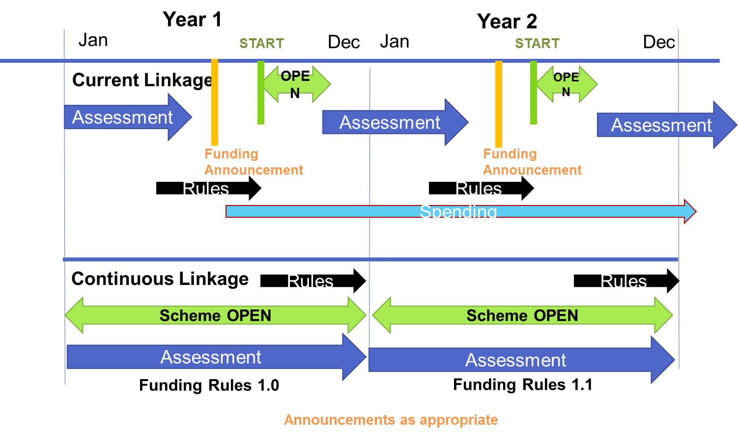
The Annual Cycle (2)

Slide 37
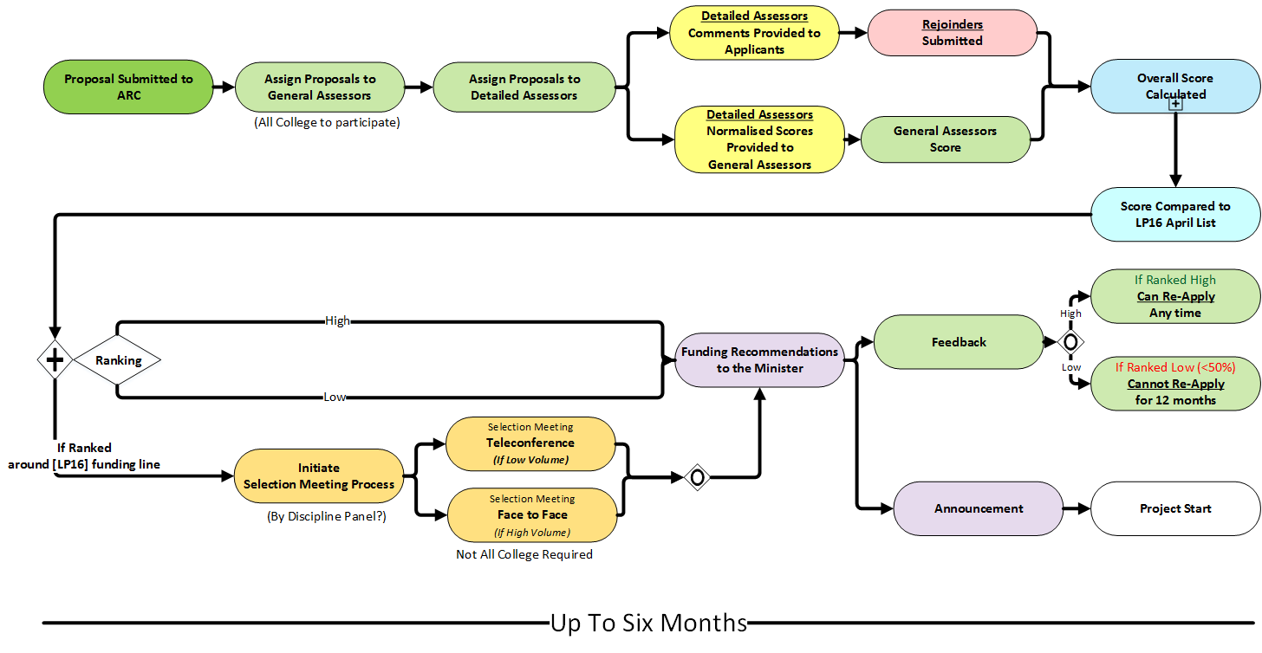
Continuous application, assessment and funding process

Slide 38
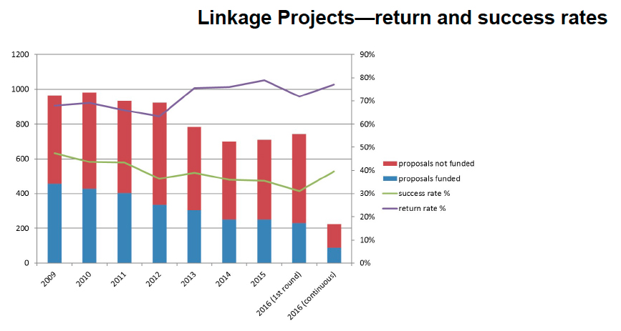

Slide 39
Discovery Early Career Researcher Awards (DECRAs)
support excellent basic and applied research by early career researchers;
advance promising early career researchers and promote enhanced opportunities for diverse career pathways;
enable research and research training in high quality and supportive environments;

Slide 40
DECRAs
Researchers may be eligible to apply if they have been awarded a PhD within five years, or longer if combined with periods of significant career interruption.
Can only apply for up to two DECRAs over the period in which they are eligible.
Up to 200 three-year DECRAs, including up to $40 000 per annum in project funds, may be awarded each year.

Slide 41
DECRA commitments
The DECRA Recipient is expected to spend 80 per cent of time on research activities related to the proposed DECRA.
The DECRA Recipient may spend up to 0.2 of her/his time annually on teaching activities. (Supervision of Honours or postgraduate students is not included in this limit.)

Slide 42
Selection Criteria - DECRA
Proposed Project Quality and Innovation 35%
  Does the research address a significant problem?
  Is the conceptual/theoretical framework innovative and original?
  What is the potential for the research to contribute to the Science and Research Priorities?)

Slide 43
Selection Criteria - DECRA
b. DECRA Candidate 40%
Research opportunity and performance evidence (ROPE),
Time and capacity to undertake the proposed research

Slide 44
Selection Criteria - DECRA
c. Feasibility 10%
Do the Project’s design, participants and requested budget create confidence in the timely and successful completion of the Project?
Is there an existing, or developing, supportive and high quality environment for this Candidate, their Project and for HDR students where appropriate?
Are the necessary facilities available to complete the Project?

Slide 45
Selection Criteria - DECRA
d. Benefit and Collaboration 15% e.g.
Will the completed Project produce significant new knowledge and/or innovative economic, commercial, environmental, social and/or cultural benefit to the Australian and international community?
To what extent will the DECRA Candidate build collaborations across research organisations and/or industry and/or with other disciplines both within Australia and internationally?
Will the proposed research be cost-effective and value for money?)

Slide 46
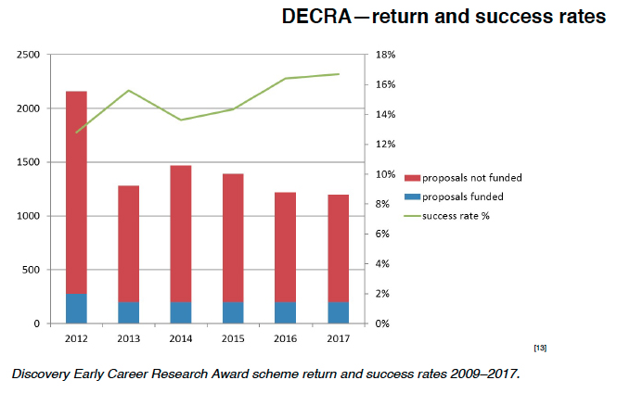

Slide 47
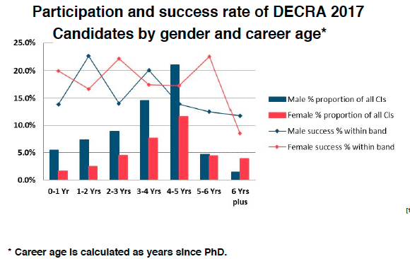

Slide 48
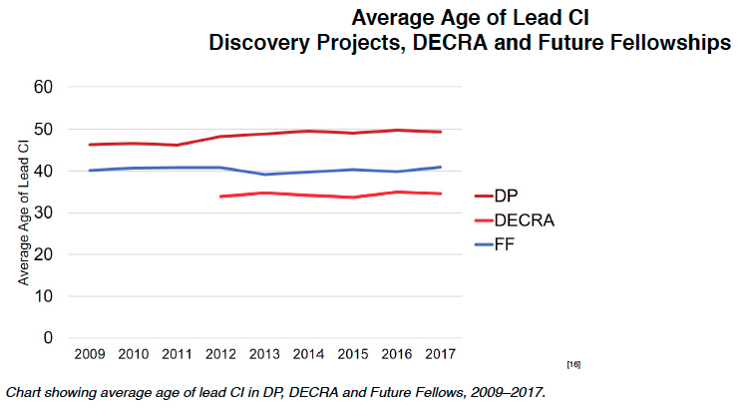

Slide 49
Questions?

